Slide 1
EU-funded research and innovation informing evidence-based action to reduce the impacts of pollution on human health
Rita Araujo
Health Innovations & Ecosystems
DG Research and Innovation
European Commission
Kick off Meeting of the ExpoHealthNet Cluster
25 September 2025

Slide 2
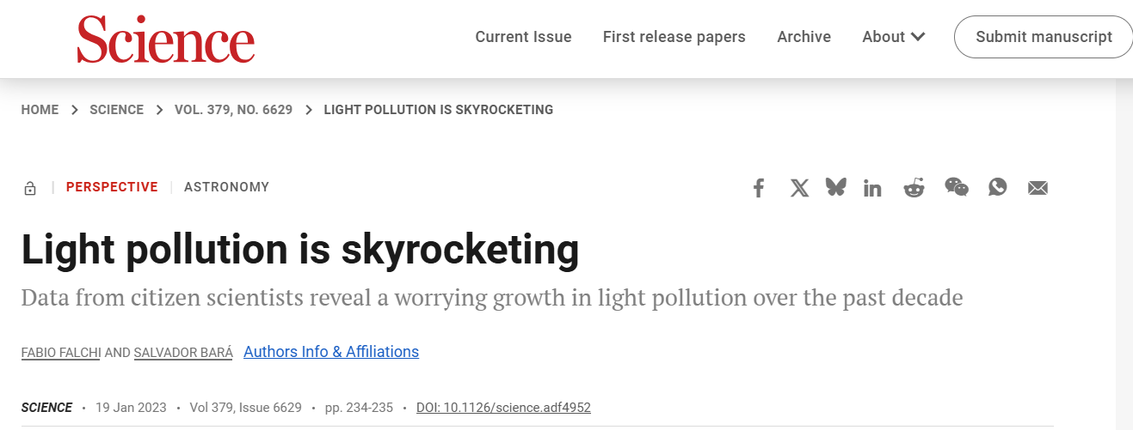
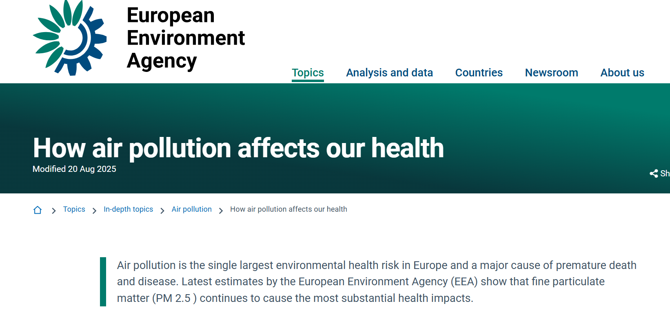
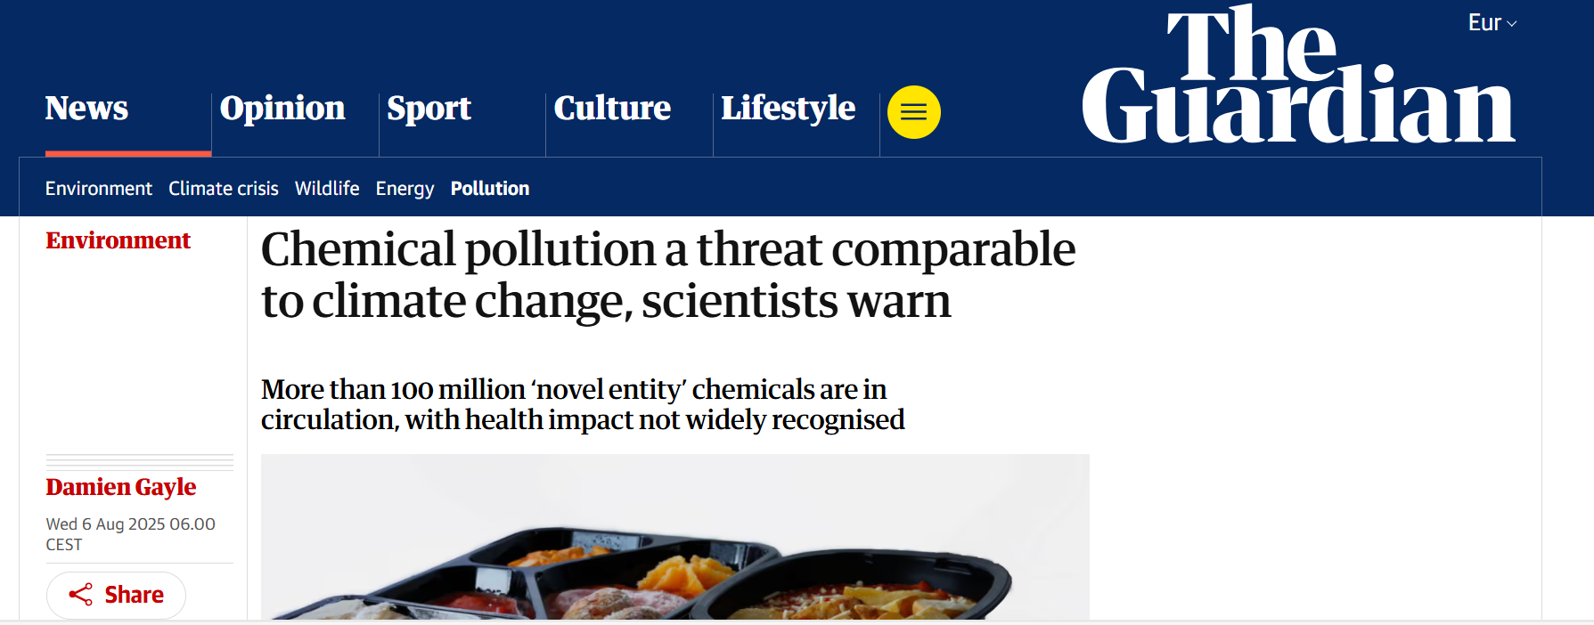
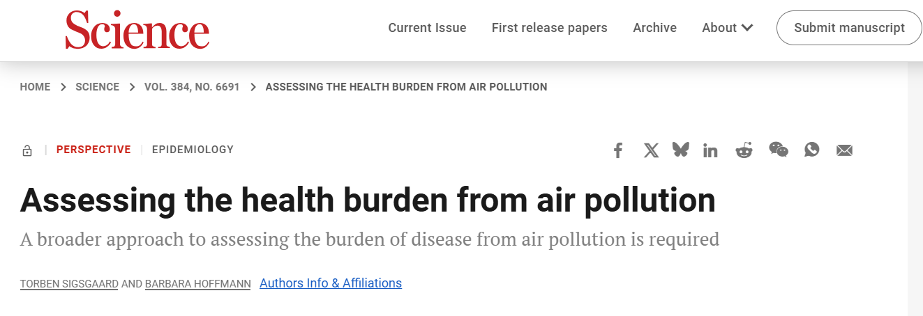
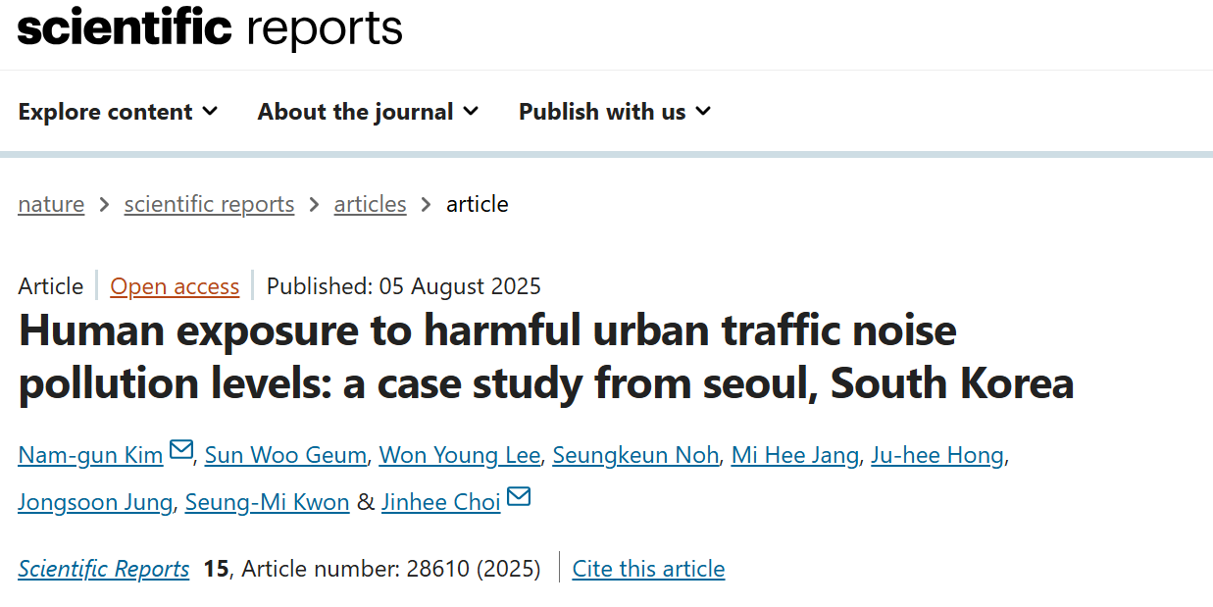
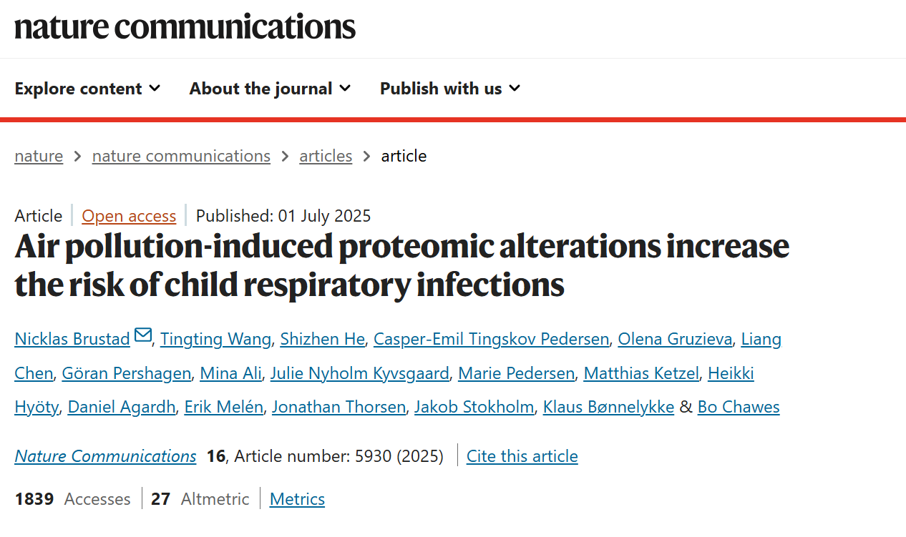
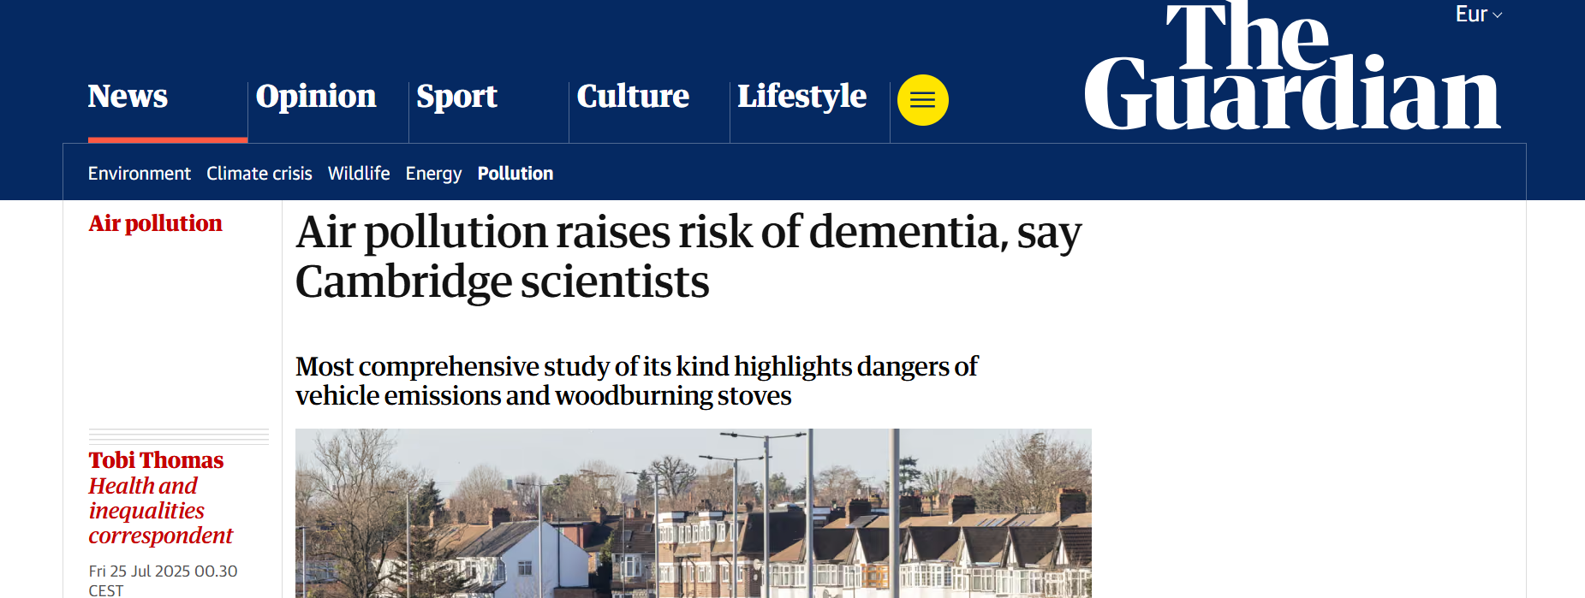
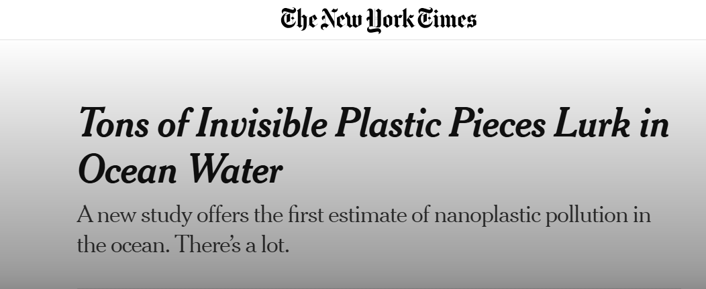
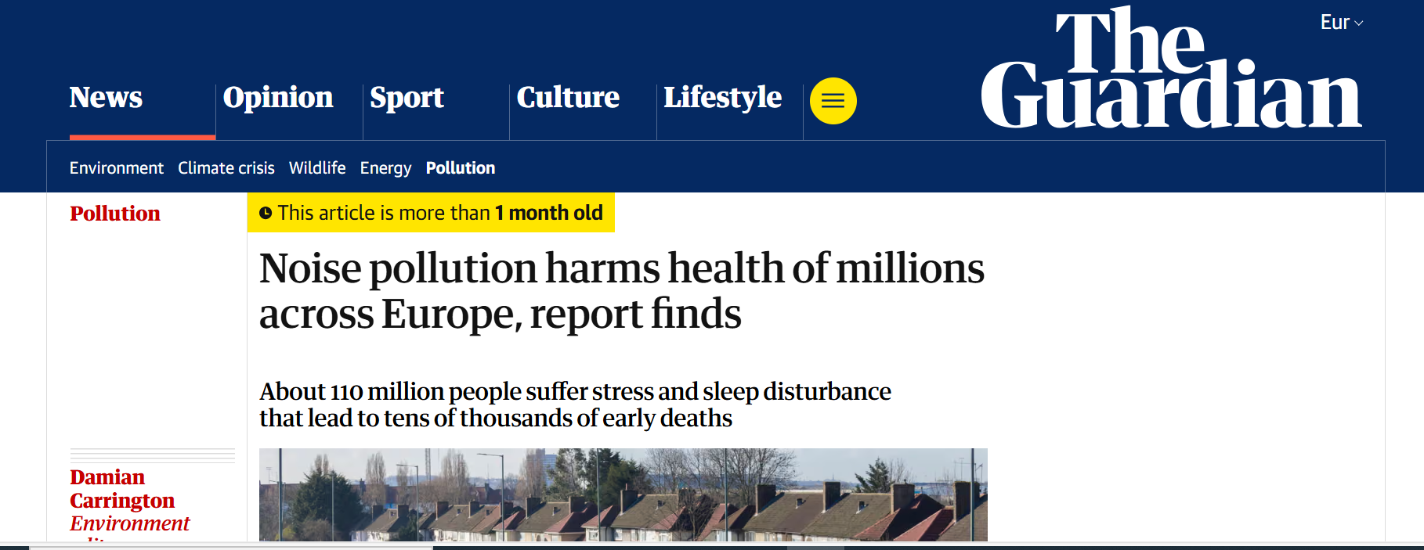

Slide 3

EU policies on micro- and nanoplastics
Circular Economy Action Plan
REACH restriction (intentional microplastics)
EU Plastics Strategy
Adopted 2018
Adopted 2020
2023
Single-Use Plastics Directive
Communication on biobased, biodegradable and compostable plastics
Proposal for a Regulation to prevent pellet losses
Entered into force 2019
Revision of EU rules on packaging and packaging waste
2022
2023

Slide 4
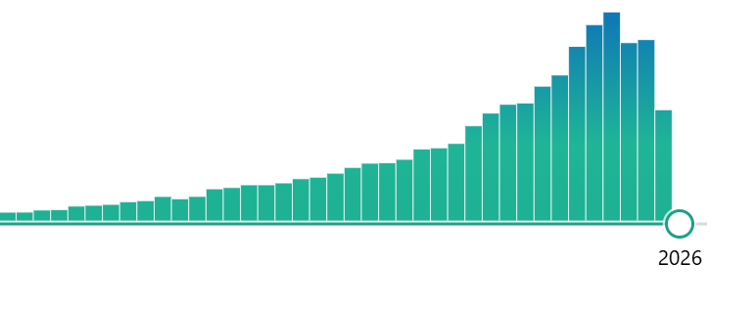
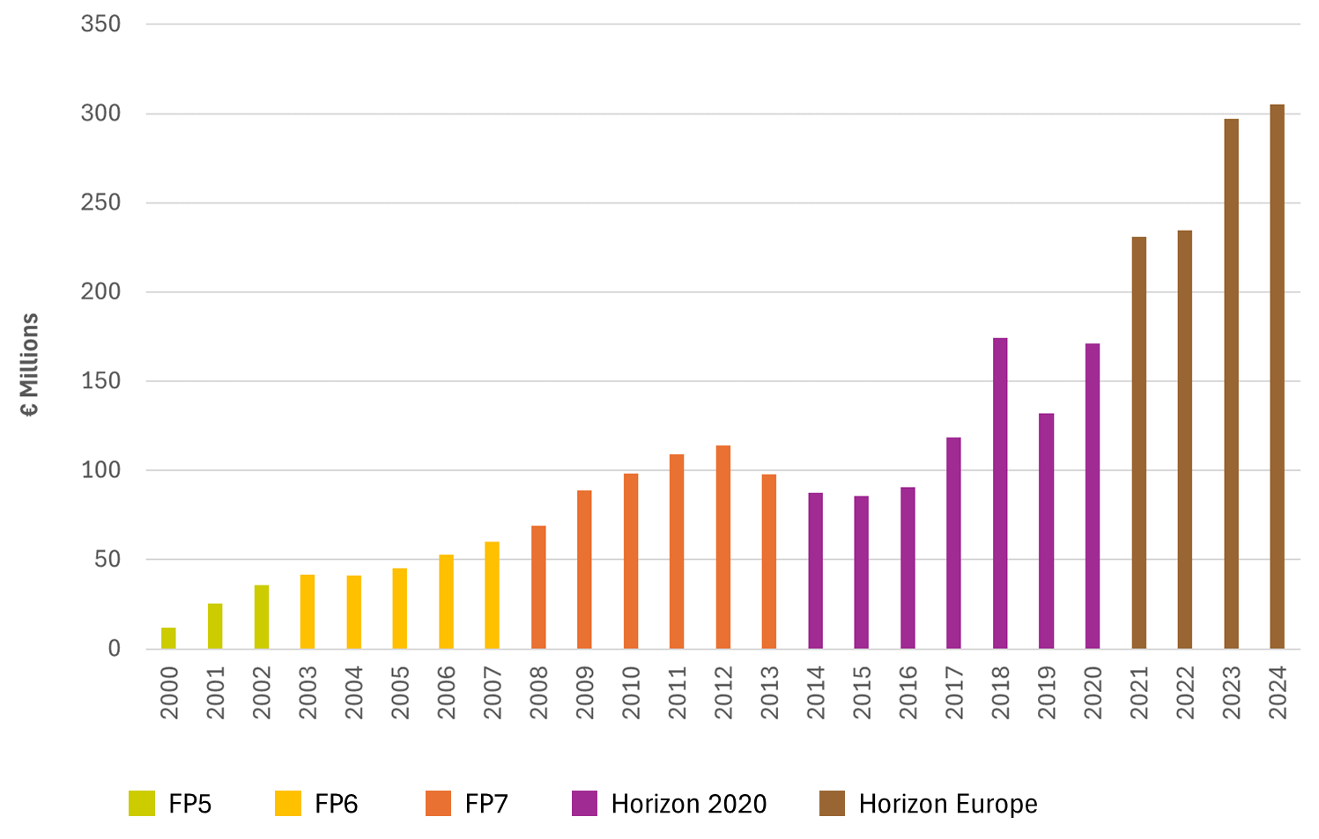
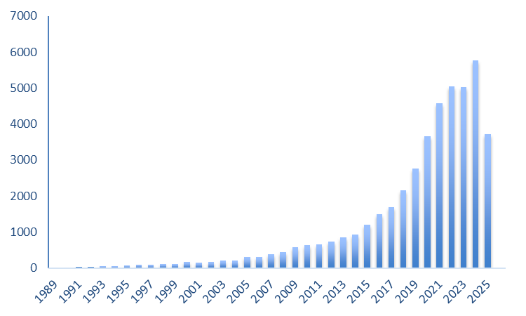
Health impacts of Pollution
Number of publications on pollution and human health
EU funded research on Environment, Climate
and Health
2010
(Source: PubMed)
(Source: Web of Science)

Slide 5
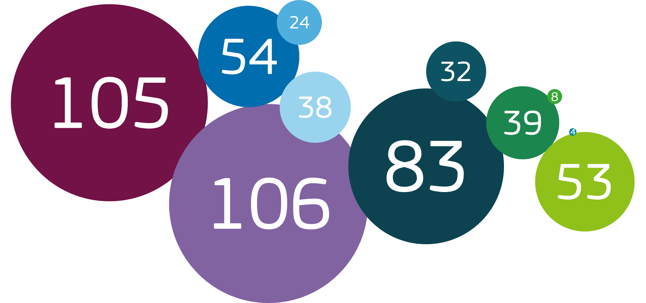
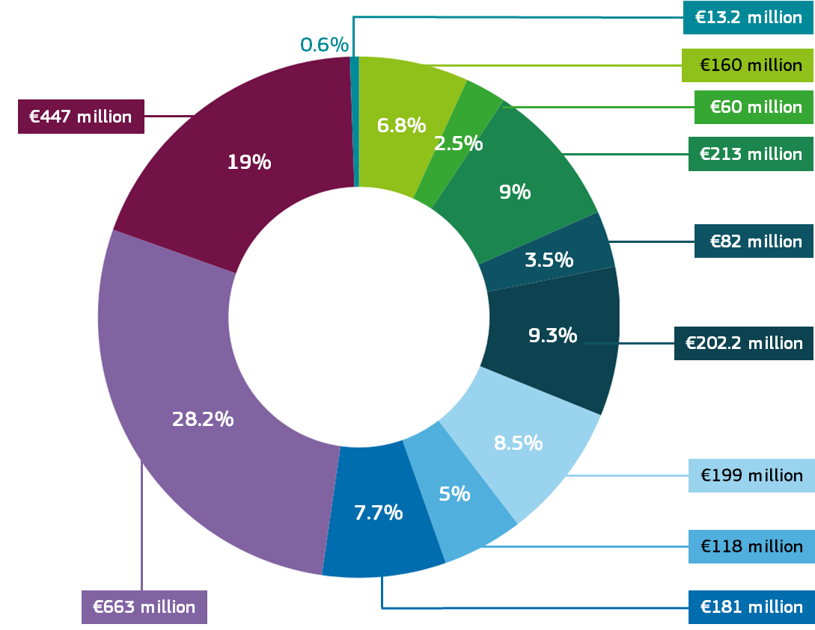
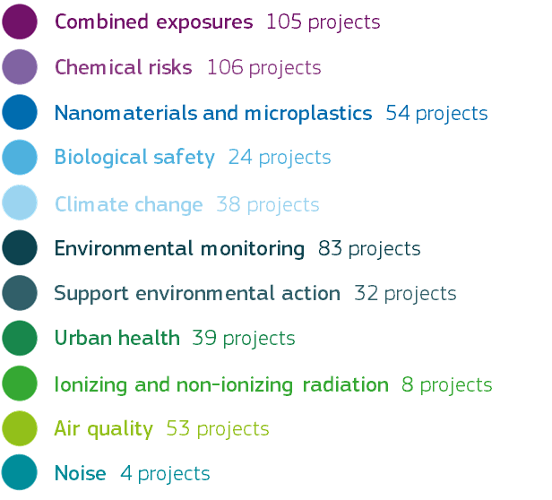
EU-funded research on pollution

Slide 6
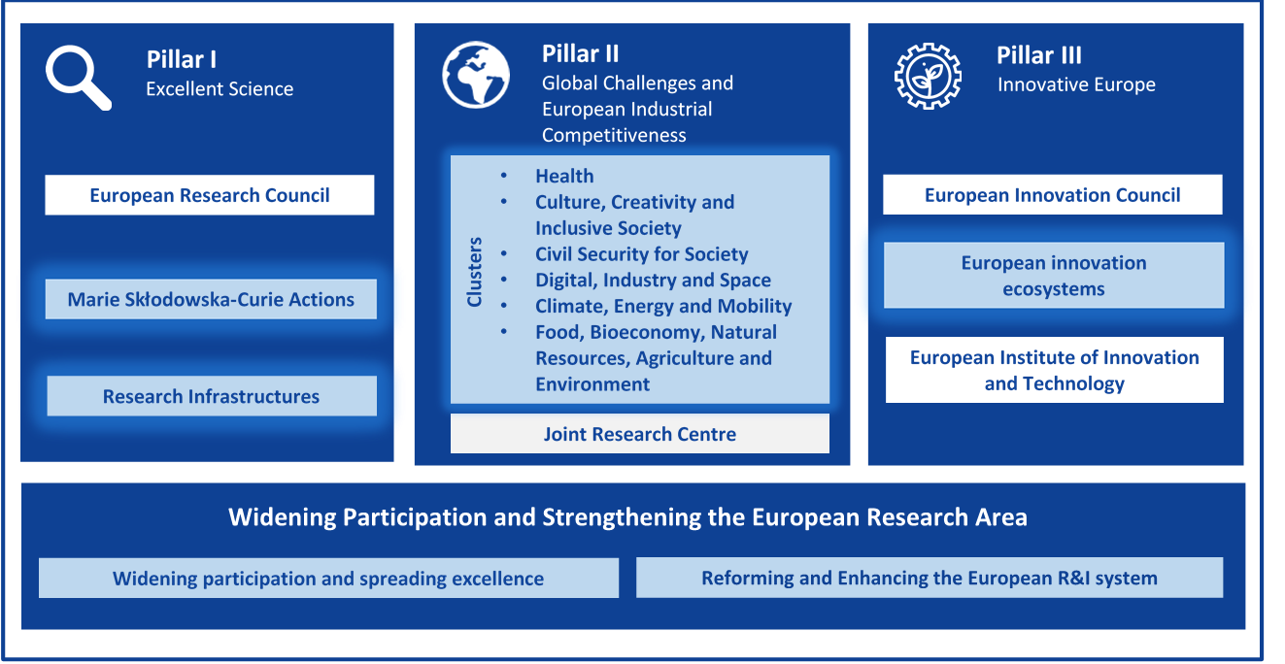

Horizon Europe supports research and innovation through Work Programmes, which set out funding opportunities for research and innovation activities
Destination 2: Living and working in a health-promoting environment.

Slide 7


Destination 2: Topics in WP 2025
HORIZON-HLTH-2025-03-ENVHLTH-01: The impact of pollution on the development and progression of brain diseases and disorders
Closure: 16.09.2025 & 16.04.26
Total: 40M€
Project size: 6-7M€
HORIZON-HLTH-2025-03-ENVHLTH-02: Advancing knowledge on the impacts of micro- and nanoplastics on human health
Closure: 16.09.2025 &16.04.26
Total: 40M€
Project size: 7-8M€

Slide 8
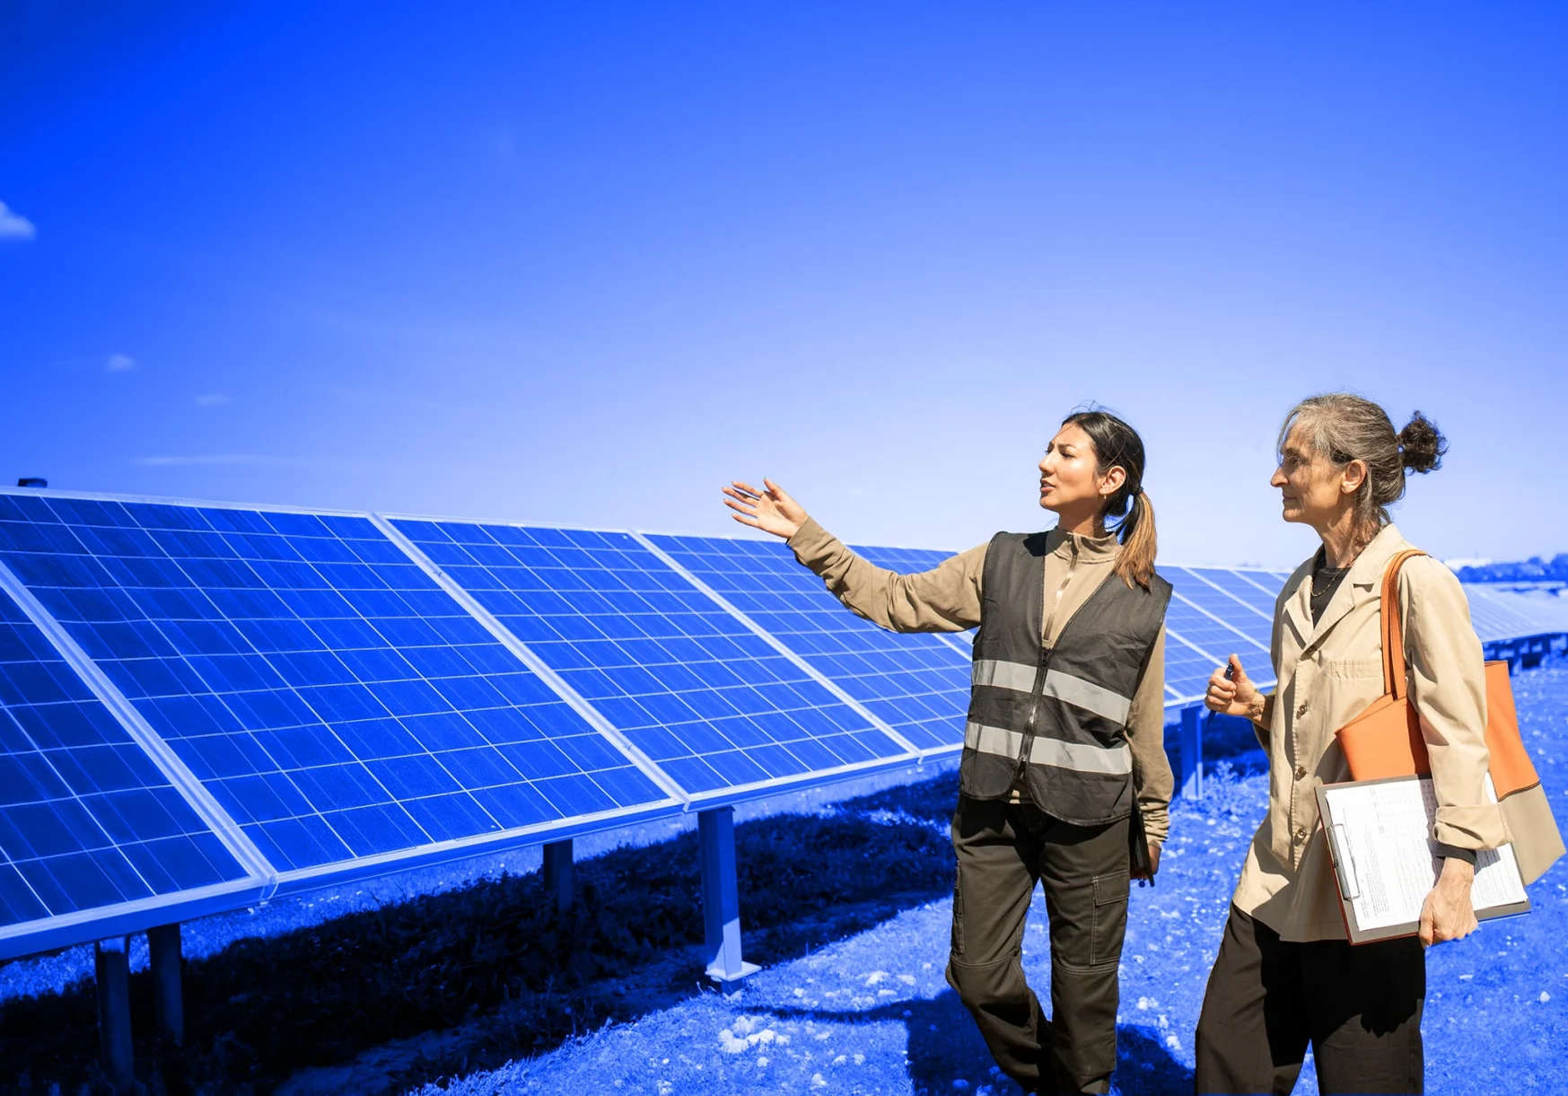
Where do we go from here?
In 2024, the European Commission revised its political priorities for the new legislative term:
Sustainable prosperity and competitiveness.
Security and defence.
Social fairness and strengthening societies.
Quality of life (food security, water and the natural environment).
Democracy and values.
Leveraging global partnerships.
Preparing our Union for the future.

Slide 9
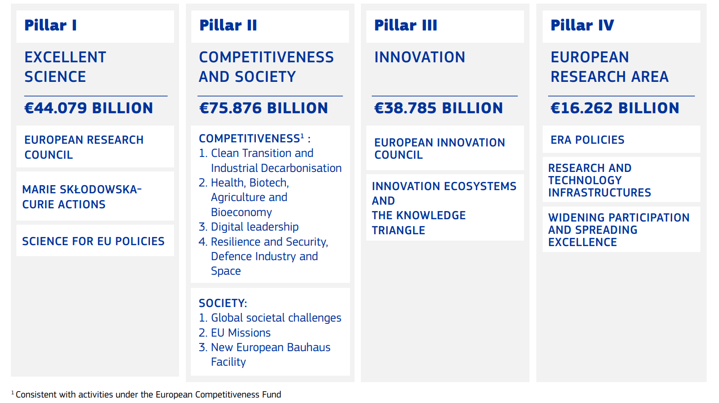
The structure of the new Horizon Europe (2028-2034)
Targets EU competitiveness on clean transition, digital leadership, industry, etc. in close cooperation with the European Competitiveness Fund.
Notes:
Decarbonisation of health
Securing of value chains
Healthy people, productivity
Technologies to tackle climate and health issues (EWS, etc.)

Slide 10
Pillar II: Competitiveness and Society
Pillar II aims to support collaborative research and innovation in areas of high societal impact.
Indicative budget : €75.9 billion, of which:
€68.3 billion for ‘Competitiveness’:
€25.3 billion for ‘Clean Transition and Industrial Decarbonisation’
€19.7 billion for ‘Health, Biotech, Agriculture and Bioeconomy’
€16.9 billion for ‘Digital Leadership’
€6.4 billion for ‘Resilience and Security, Defence Industry and Space’
€7.6 billion for ‘Society’

Slide 11
Clusters of projects under the environment, climate and health portfolio
E,C&H Clusters under Horizon 2020
EURION
EHEN
CUSP
Completed
Endocrine disruptors
(49 million EUR)
Human exposome
(105 million EUR)
MNPs and health
(30 million EUR)
UHC
Green Deal
ASPIS
Urban Health
(30 million EUR)
Persistent chemicals, PFAS, Zero Pollution
(51 million EUR)
NAMs
(60 million EUR)
E,C&H Clusters under Horizon Europe
IDEAL
Climate-Health
CLUE-H
METEOR
Indoor air quality and health
(47 million EUR)
Climate change and health
(59 million EUR)
EMFs and health
(29 million EUR)
Health-related costs of pollution
(20 million EUR)
ENKORE
WISEWORK-C
PHC
EXPOHEALTHNET
Endocrine disruptors and health
(36 million EUR)
Post-pandemic workplaces and occupational health
(28 million EUR)
Planetary health
(31 million EUR)
Pollution and NCDs
(57 million EUR)

Slide 12
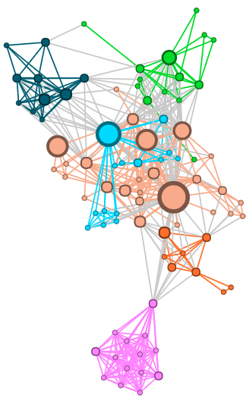
Clusters of projects: why?
Harmonisation of approaches
Strengthen Science4Policy link
Promote synergies and networking
Capacity building
Streamline information flows
Communication and dissemination: maximises outreach
Increased IMPACT & COORDINATION

Slide 13
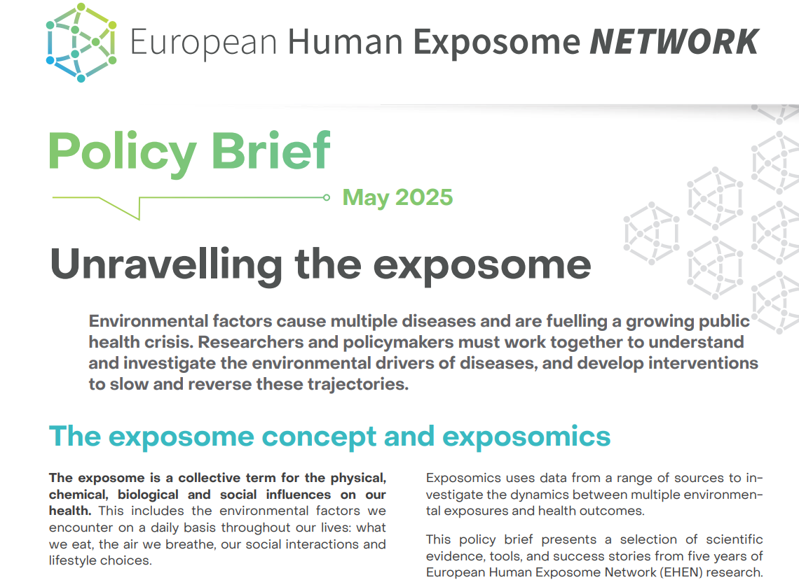
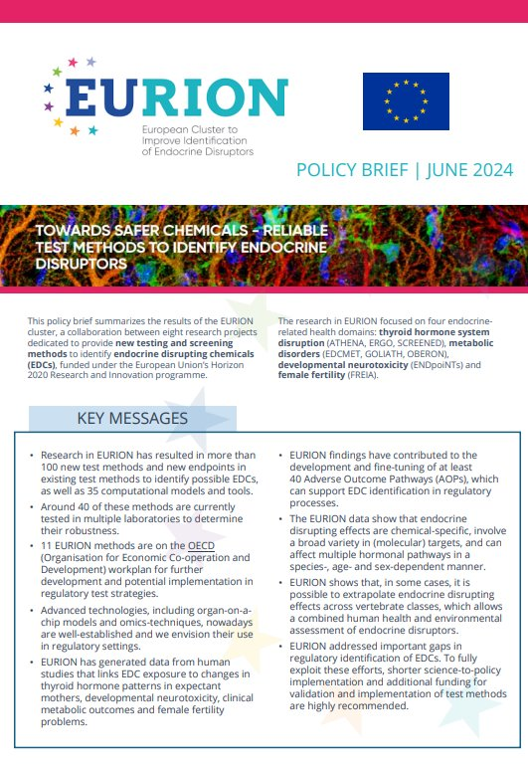
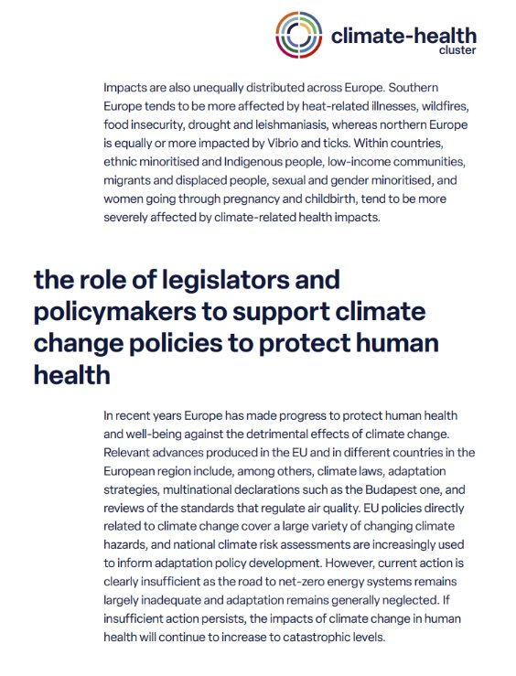
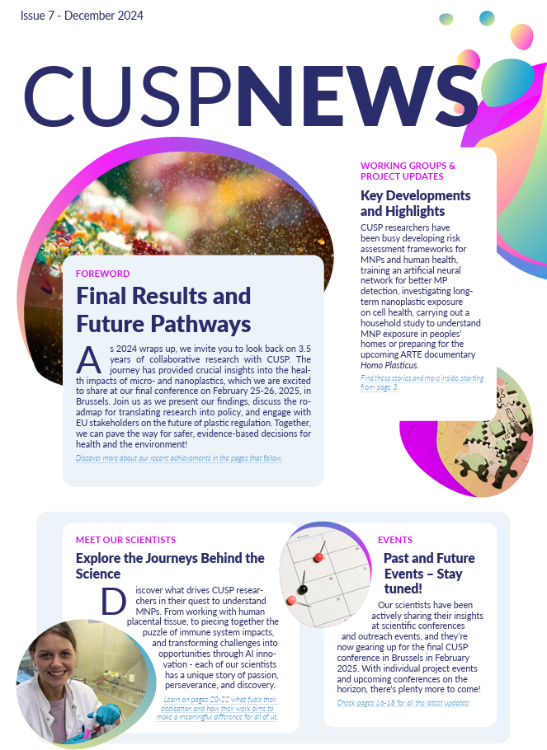



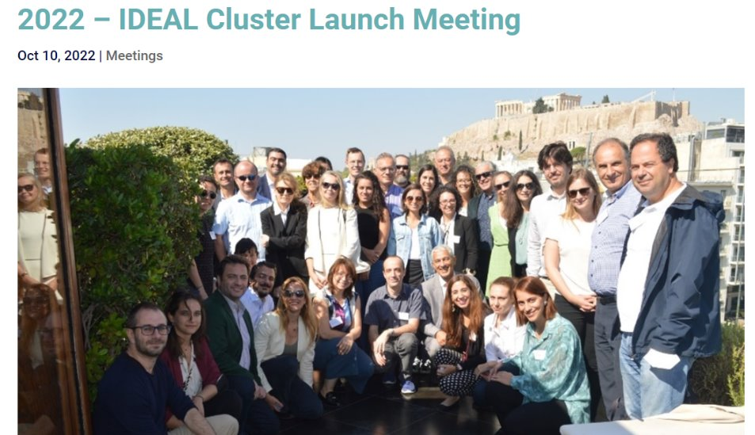
Creating impact through joint activities

Slide 14




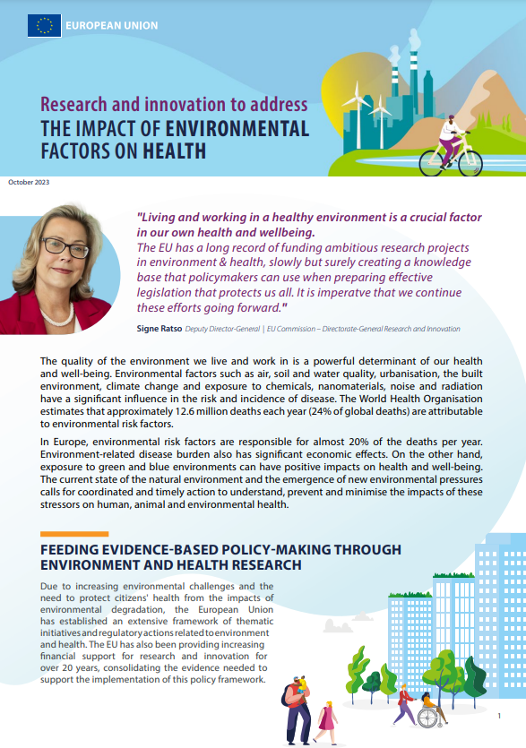
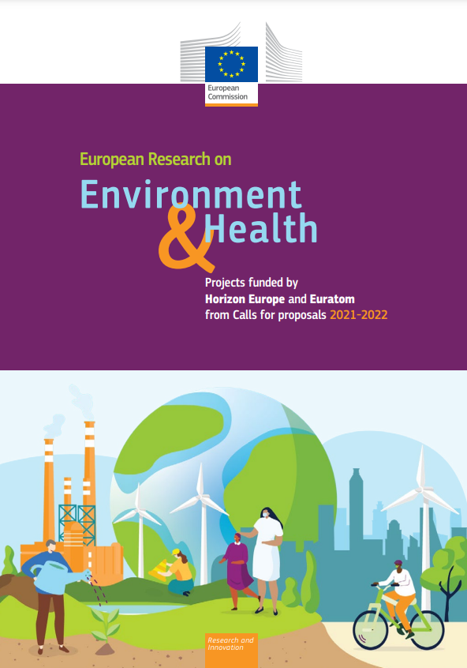
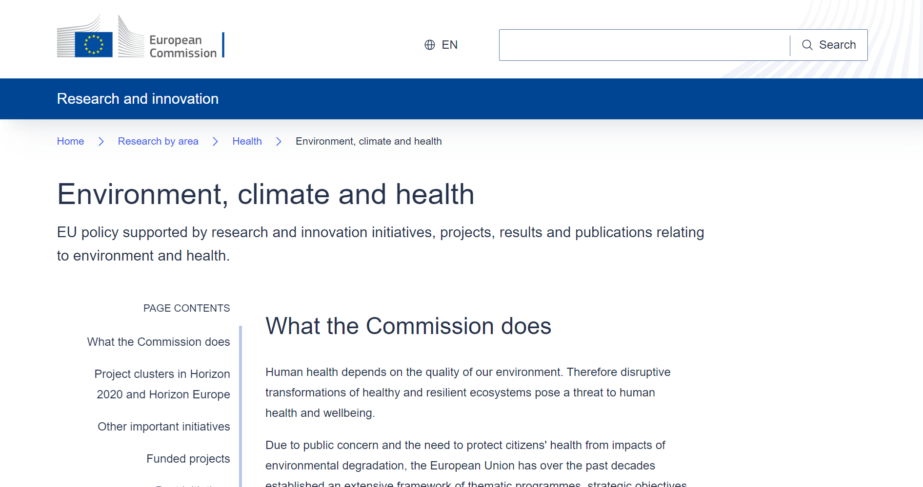



Thank you!
Visit our website
Read our factsheet
Read our catalogue
https://europa.eu/!NMb6Jv
https://op.europa.eu/s/zJBn
https://op.europa.eu/s/zJBo

