Slide 1



ENACT
Environmental Effect on Health Care and Wellbeing and Active Interventions
September 25th,2025 | Dea Jancic, AIOTI

Slide 2
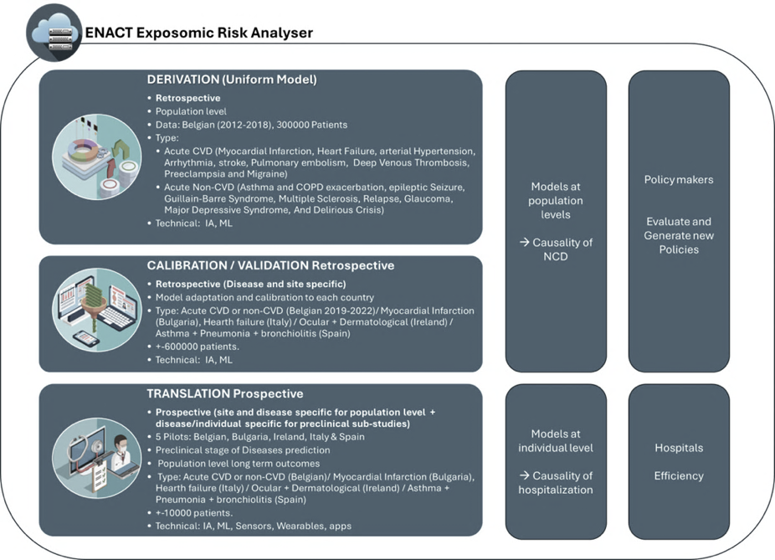


Scientific challenge and context
The What! - ENACT
How environmental stressors (air, water, noise, allergens, humidity)
are responsible for NCDs (CVD, Respiratory, Ocular, dermatological)
Translates “population-level” exposomic models into ”individual-level”
The How! AI-Driven Environmental Health Modelling
EU Digital Continuum: 5 pilots- Belgium, Bulgaria, Ireland, Italy, & Spain,
  Cross-border learning and harmonized urban health strategies
Federated Data Infrastructure
Privacy-preserving, enabling scalable and ethical AI
🔐
To Whom! Citizen, Health providers & Policy makers
Interactive visualization tools and services targeted stakeholders
Bridging the gap: data and action → urban health governance.
Environmental and Policy Impact
Evidence-based recommendations for:
  Pollution management
  Urban planning
Within EU and global sustainability strategies.
🌱

Slide 3
Scientific challenge and context
Transformational infrastructure that bridges
environmental intelligence, predictive health, and policy innovation
Pan-EU exposomic Risk Score: How pollution affects our health (short/long term) “translating causal insights” to:
.
POLICYMAKERS
CITIZENS
HEALTH PROVIDERS
Evidences on Urban Planning
Personalized Risk Awareness
Clinical Support
Policy Evaluation & Monitoring
Early Detection & Prevention
Population Health Management
Empowerment & Engagement
Empowerment & Engagement
Training & Capacity (material)
Transparent reproducible Policy
Briefs tailored to local
Early detection / QoL
Individual Exposomic Risk (personalized)
Proactive management
Safer Urban living
Health System Preparedness (Reduce Financial Burden) & Scalable Models

Slide 4
Scientific approach
Four pillars for innovation sustainability
Impact by design
Social Impact Value Chain
Evidence-based
Innovation Adoption
Evaluation embedded from the start
from inputs → systemic impacts
stakeholder-driven approach
tailored to diverse end-users, integrating behavioural change

Slide 5





Scientific approach
Co-creation with local stakeholders (needs definition etc.)
Definition of evaluation protocols (e.g. identification of SMART KPIs) and innovation adoption approach
EVIDENCE generation and impact analysis
Impact maximisation with local stakeholders
Continuous feedback loops for iterative improvements

Slide 6
Key expected results
Contribution to ENACT’s overall impact maximisation strategy
Evidence generation to support scaling & replication of ENACT pilots
Policy-relevant outputs
Supporting the long-term societal adoption of ENACT solutions
ENACT will address the short-term and long-term effects of environmental effects on health
ENACT’s main ambition is to shed the light into the following state of the art main research areas through the implementation of five aligned pilot sites (Belgium, Bulgaria, Ireland, Italy, Spain):
(1) How environmental stressors like air and water pollutants, greenhouse gases, ground UV radiation, airborne pollen concentration, aeroallergens, change in humidity and urban noise, are responsible for NCDs including ocular and dermatological conditions, cardiovascular diseases and pulmonary diseases.
(2) Interactions between environmental and non-environmental stressors working at both the individual and the population level on (a) ER/ICU hospital admission for acute vascular diseases (myocardial infarction, acute heart failure, strokes, lung embolism, preeclampsia, acute heart failure) and acute non-vascular diseases (COPD exacerbation, asthma); and (b) Development of preclinical stages of disease,
(3) How adequate and evidence based recommendation and lessons learnt can support changes in pollution management in accordance to EU and international strategies.
A risk based exposomic approach is now necessary and will be developed to improve our actual limited comprehension of environmental risk by taking into consideration the full spectrum of environmental factors and potential predisposal factors
This will be accomplished based on extensive and complementary knowhow of the Consortium partners, and a set of technological assets they bring into the project

Slide 7




Expected political and societal impact
Transformational infrastructure that bridges
environmental intelligence, predictive health, and policy innovation.
EVIDENCE AGREGATION
DATA COLLECTION
EVALUATION PREPARATION
🧪
Scientific Validity / Robustness
Risk attribution
Evaluation and benchmarking
Policy and Public Trust
Evidence-based governance
📊
Evaluation & Benchmarking
Causal Activity
Clinical Utility
Engagement
Scientific Validity and Model Accuracy
(Risk producing biased or misleading predictions)
Causal Inference and Risk Attribution
Linking Health and Environment / data integration strategy
✅
📊
🏥
🏛️
🏙️

Slide 8
https://enact-he.eu/

