Slide 1



ENVESOME The Environmental Exposome And Health
September 25th,2025
Prof. Dimosthenis Sarigiannis
National Hellenic Research Foundation;
Aristotle University of Thessaloniki;
School for Advanced Study (IUSS)

Slide 2
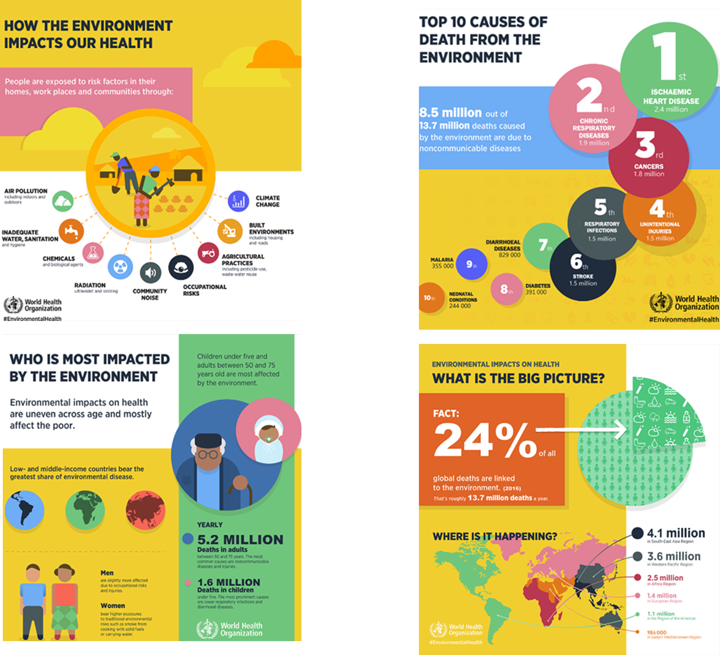
Scientific challenge and context
Why ENVESOME?
Over 75% of EU citizens live in cities, exposed daily to a mixture of stressors:
Air pollution, noise, artificial light, hazardous chemicals (incl. waste)
Climate change impacts (heatwaves, humidity)
Social inequalities that amplify risks
These cumulative exposures drive the rise of non-communicable diseases (NCDs)
NCDs account for ~80% of the EU’s disease burden → urgent need to decode environment–health interactions.
Our Mission
A transformative initiative to bridge science, policy, and society by:
Reducing environmental health risks
Promoting health equity
Driving sustainable change in Europe’s cities and beyond

Slide 3
What Makes ENVESOME Unique?
An integrated, beyond state-of-the-art approach:
Human biomonitoring (targeted & untargeted)
In vitro studies & multi-omics integration
Systems biology & advanced exposure modelling
Innovative sensor technologies
👉 Powered by the INTEGRA platform & agent-based models to simulate realistic lifetime exposures across populations (age, lifestyle, socioeconomic status, geography).
From Biology to Impact
High-dimensional biology reveals how exposures disrupt pathways → dose-response data & thresholds for biological effects
Towards new exposure limits and evidence-based prevention strategies
Tested in Urban Living Labs (ULLs) → communities co-create healthier environments
Turning Data into Action
ENVESOME translates complex science into real-world solutions:
AI decision-support tools for policymakers & planners
Intelligent chatbots for healthcare professionals
Personalized coaching apps for citizens

Slide 4
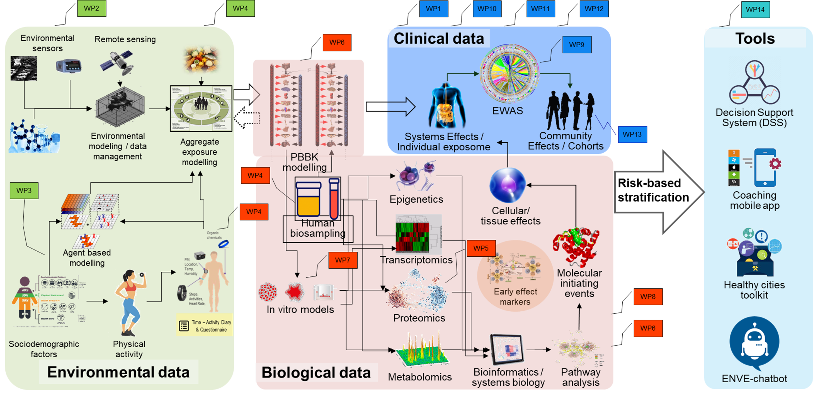
Scientific approach

Slide 5
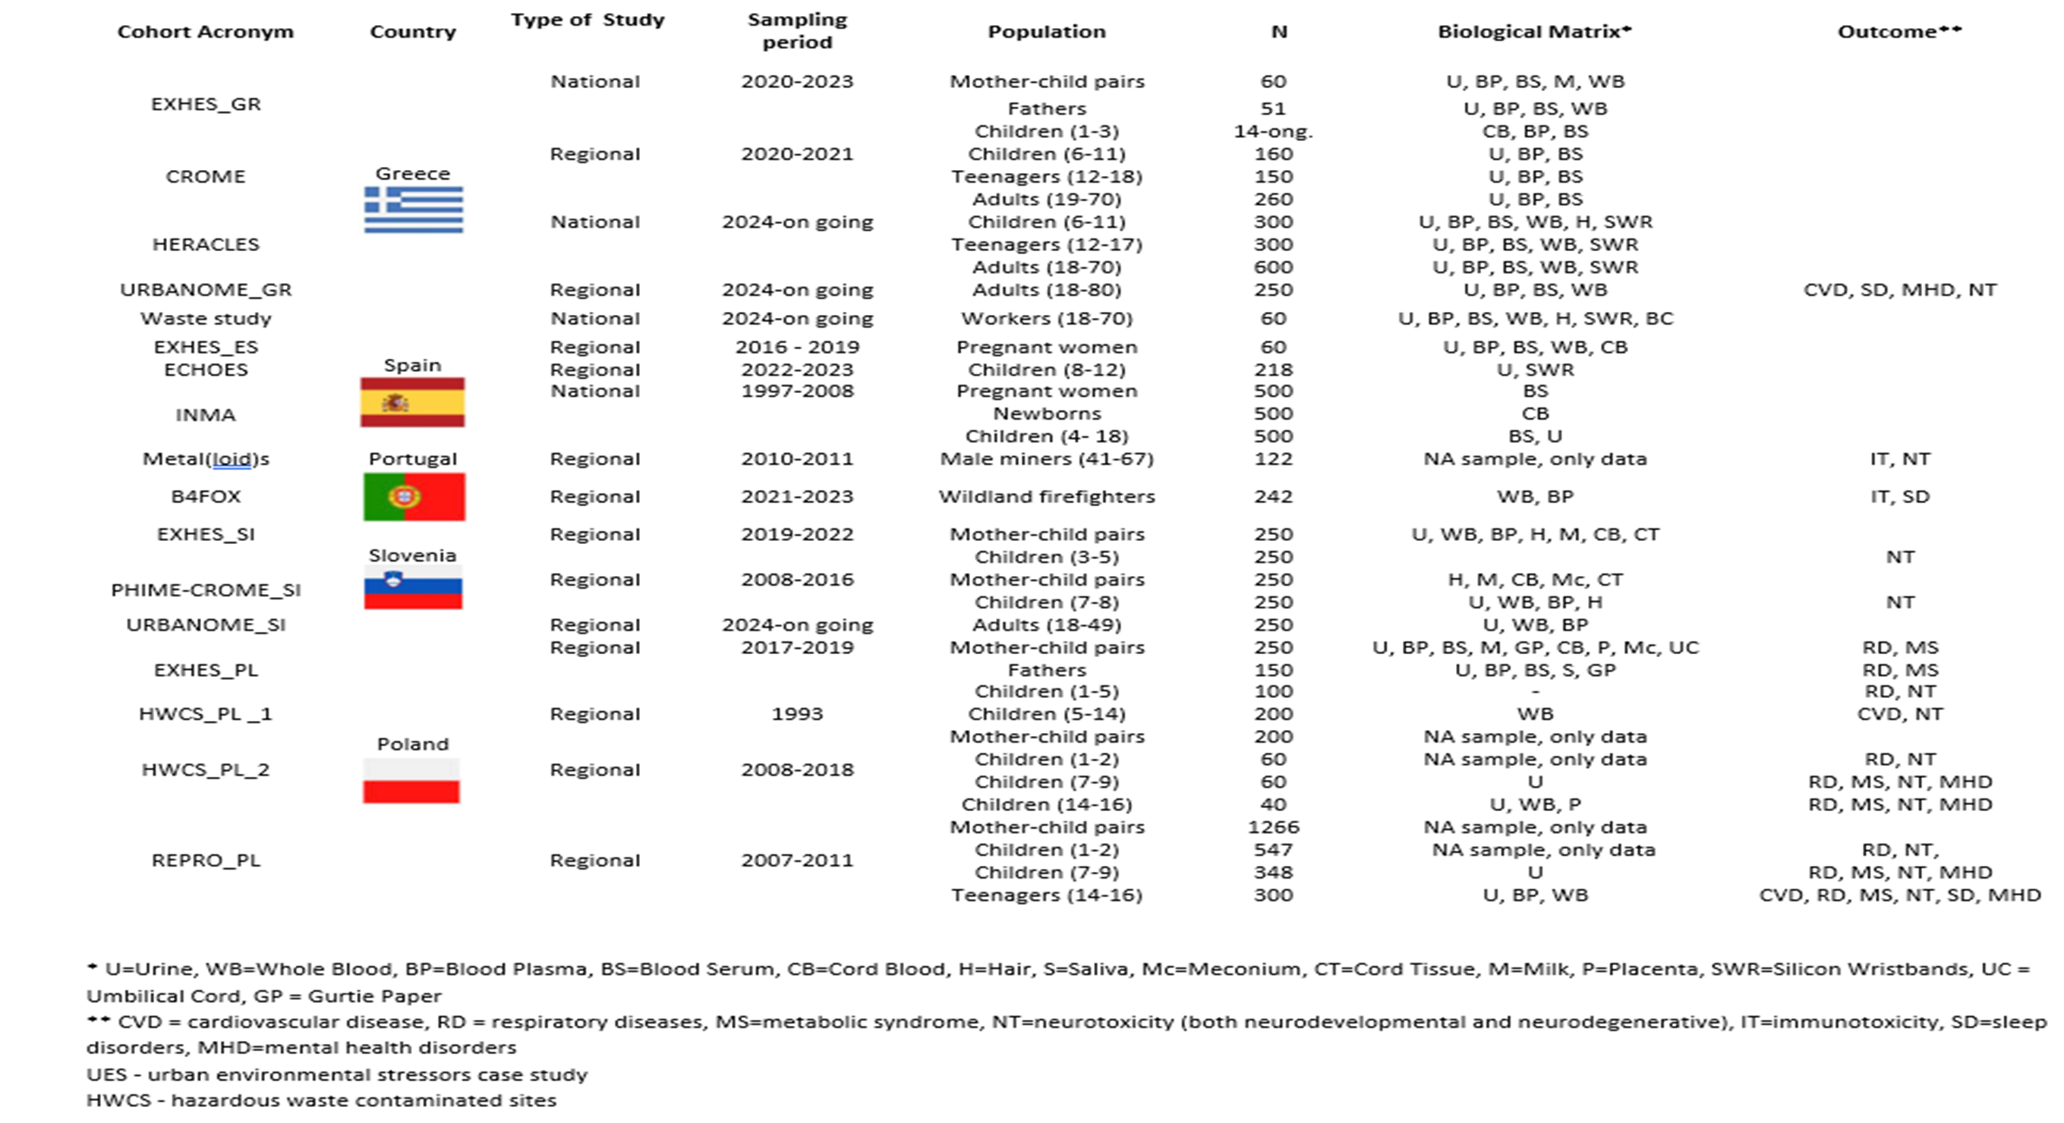
The ENVESOME Pre - Existing Cohorts
22 cohorts spread across 6 different EU countries.
The total population includes 17,000 participants and refers to the different life periods.
ENVESOME Inventory & Harmonized Codebook fully compliant with the FAIR principles.

Slide 6
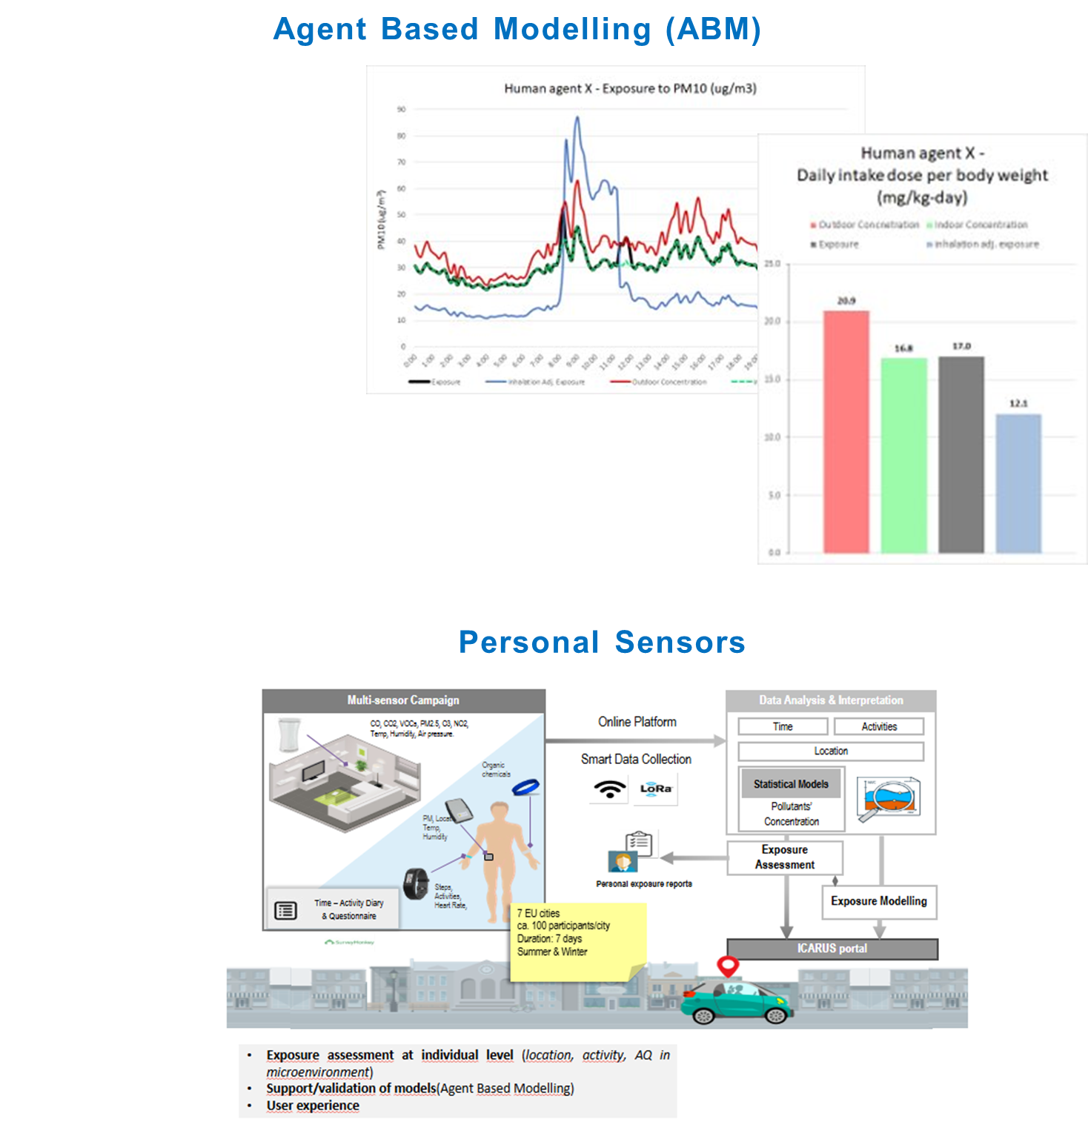
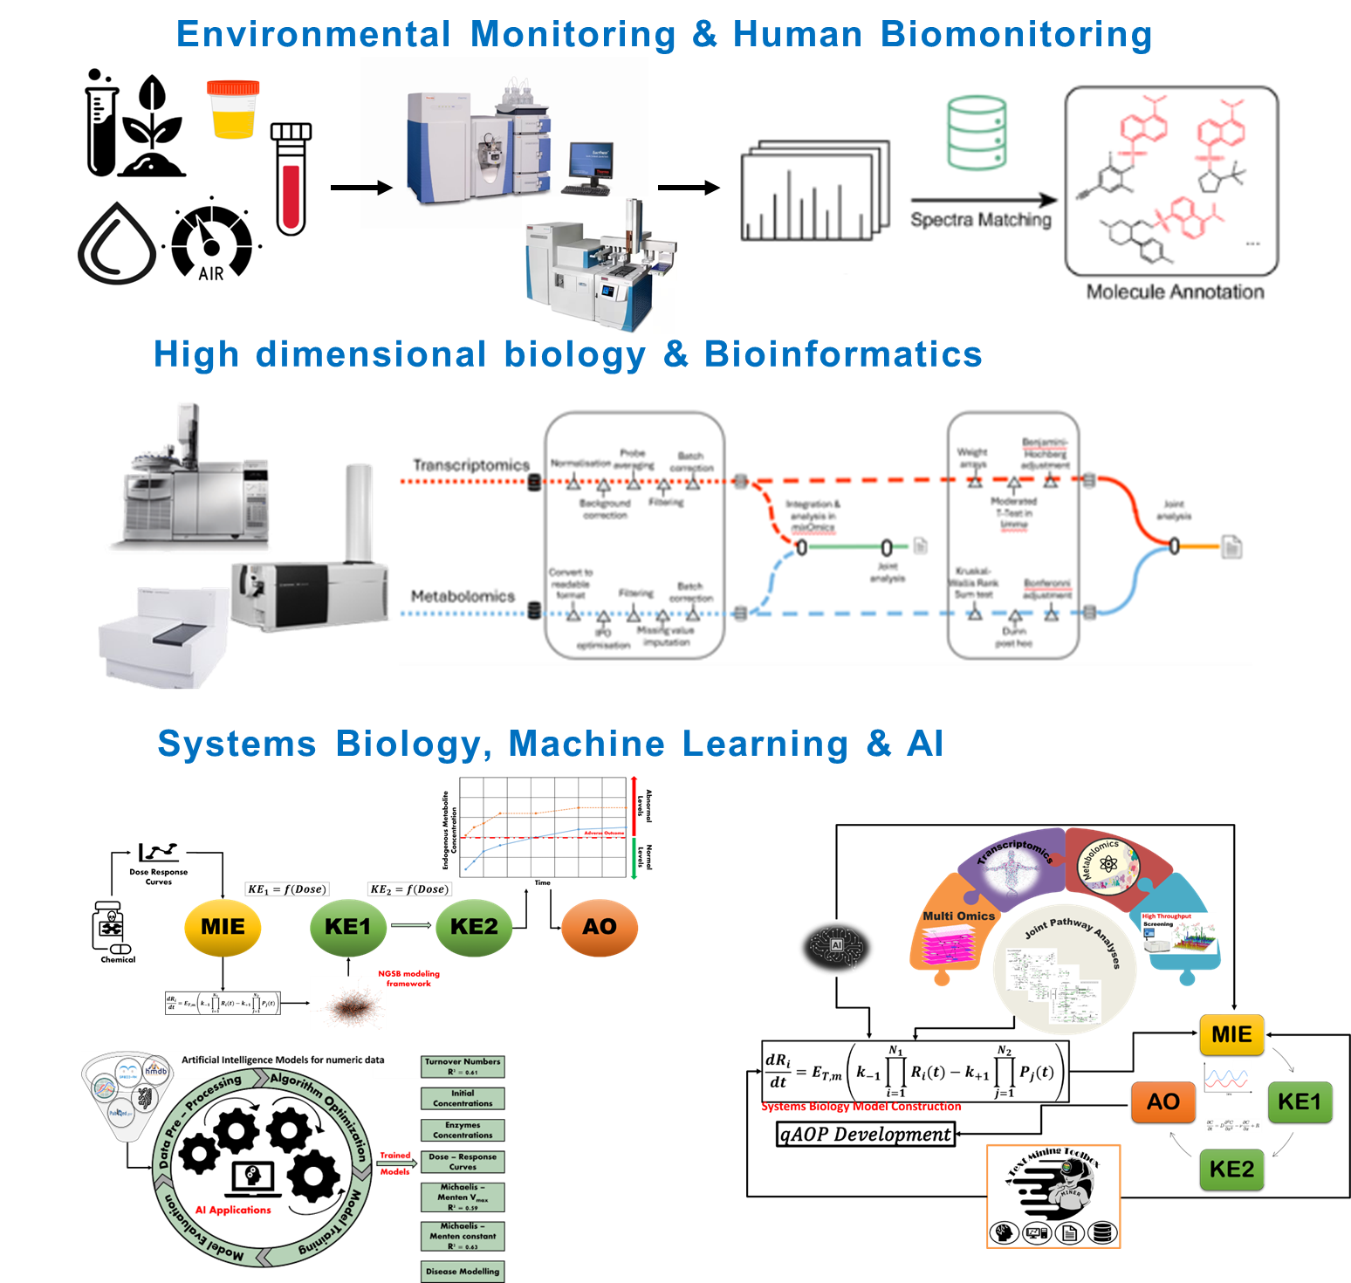

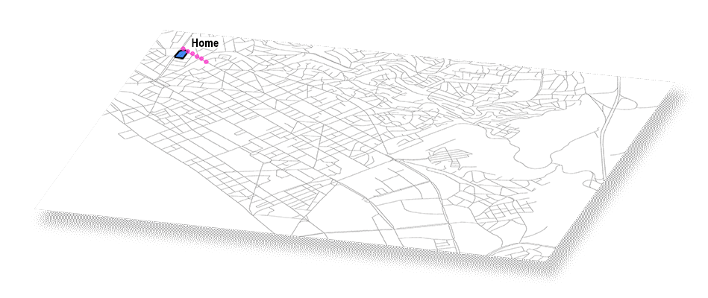
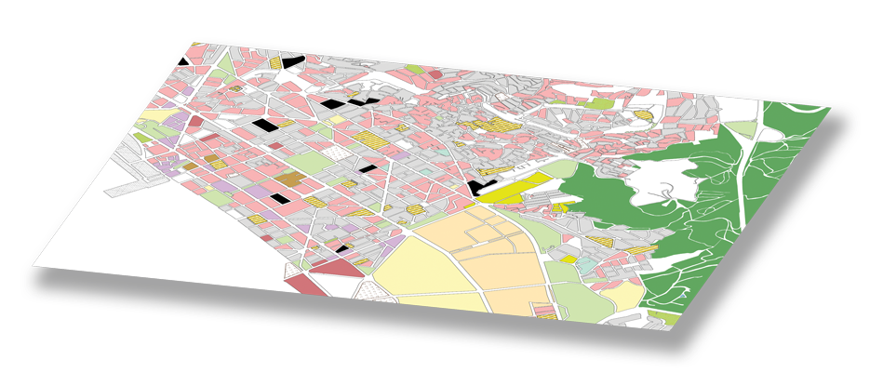
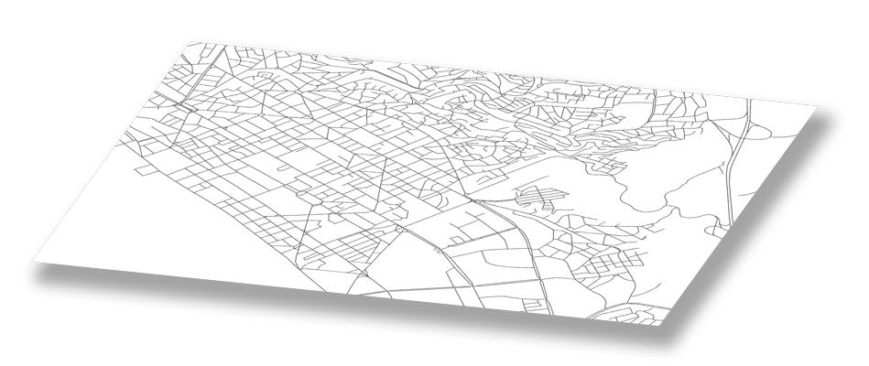
The ENVESOME Toolbox
Air Quality Data
Human Agent Trajectories
Buildings, Land Use
Road Network

Slide 7
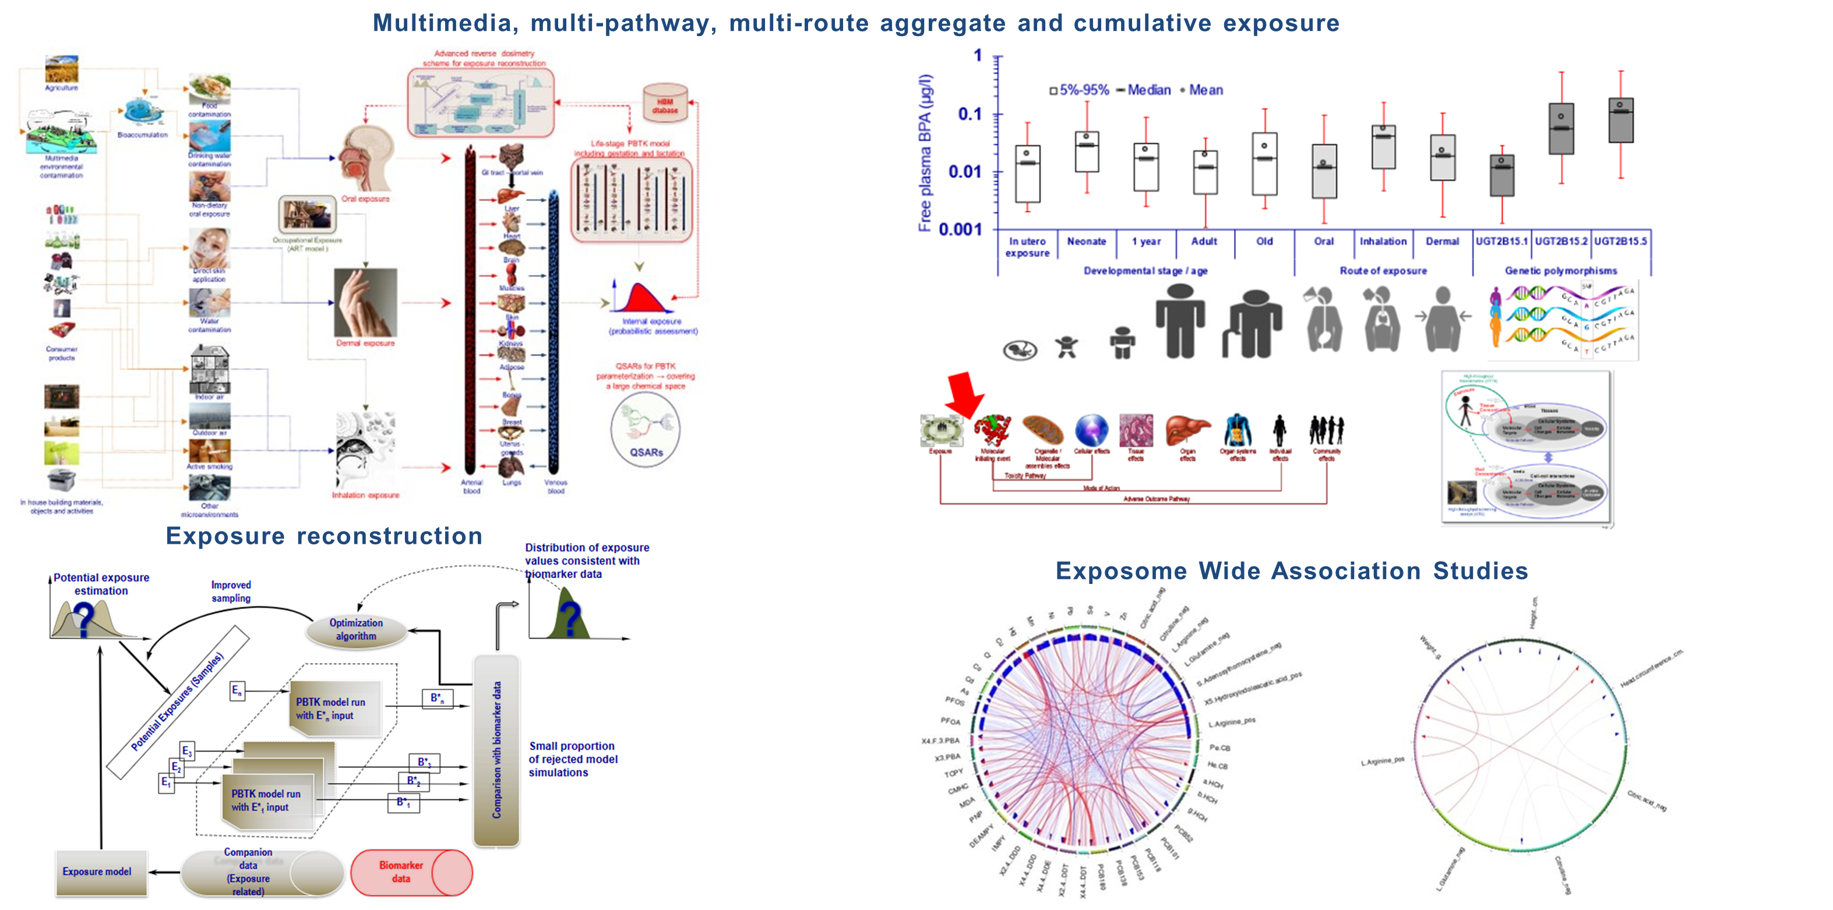
The ENVESOME Toolbox

Slide 8
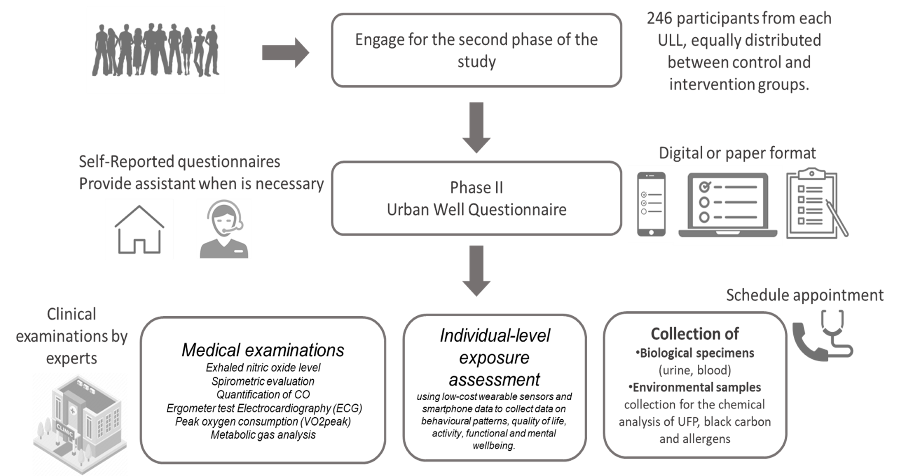
The ENVESOME Cohorts
The URBAN Well
Urban Well will be an exposome study, with interventions, that will innovate solutions for the effects of combined chemical and physical urban stressors – including ultrafine particles (UFP), black carbon (BC), aeroallergens, noise, and light – on a range of health outcome.
By utilizing an integrative methodology that encompasses molecular, epidemiological, and exposome research, Urban Well will carry out real-life exposure assessments in 10 European cities (Athens, Thessaloniki, Ljubljana, Barcelona, Madrid, Porto, Vienna, Berlin, Lodz, Aarhus).

Slide 9
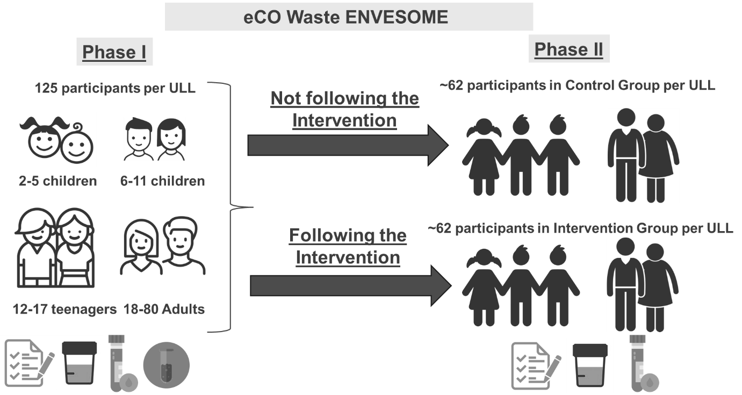
The ENVESOME Cohorts
The Eco Waste
The eCO Waste ENVESOME study proposes to conduct an intervention exposome investigation focusing on the impact of environmental contamination resulting from waste management practices in urban and peri-urban settings on neurotoxicity (NT) metabolic syndrome (MS), and (developmental) immunotoxicity (IT) in participants aged 2 – 80 yeas old.
Through an integrative approach encompassing molecular, epidemiological, and exposome methodologies, the eCO Waste ENVESOME study aims to conduct real-life exposure assessments in the 4 selected ENVESOME ULLs that will be enrolled (Athens, Madrid, Porto, Lodz).

Slide 10
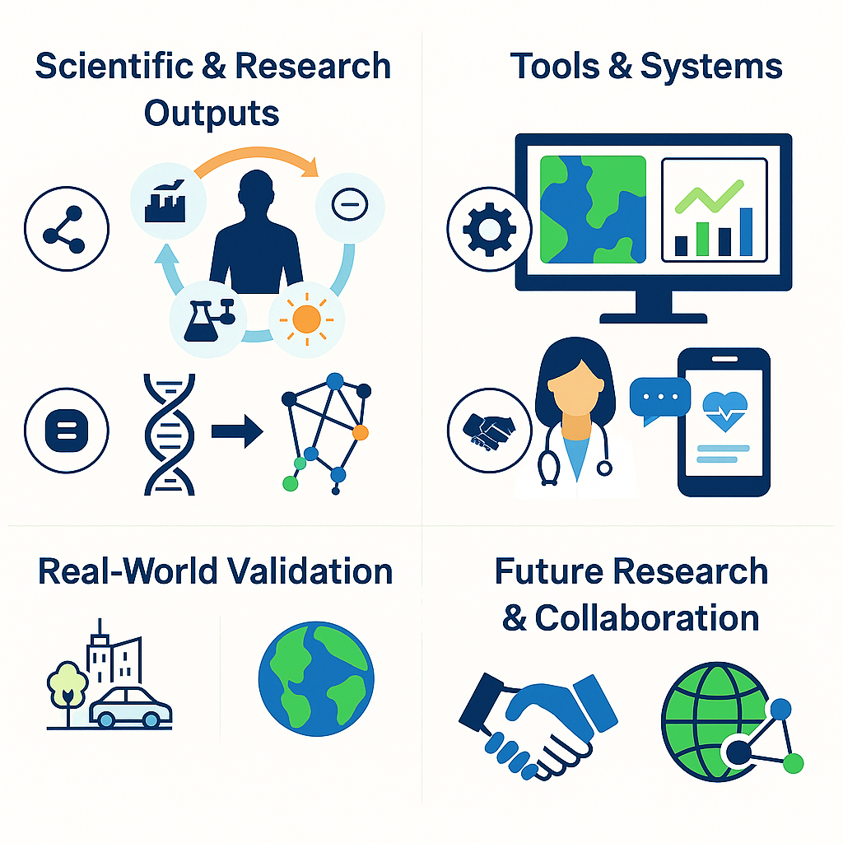
Key expected results
Scientific & Research Outputs
Exposure Models: Aggregate, agent-based, and life-course models for cumulative exposure & internal dosimetry
Biomarkers: Early-effect biomarkers (EEBs) and molecular signatures from multi-omics, enabling early detection of environment-driven disease risks
Pathway-Based Insights: Systems biology models, Adverse Outcome Pathways (AOPs) & Networks (AONs) linking exposures to NCDs
Data Resources: FAIR databases integrating environmental, biomonitoring & health data
Tools & Systems
AI-powered Decision Support System (DSS) for policymakers & regulators
Healthy Cities Toolkit for urban planners & authorities
Digital Health Tools: Mobile coaching apps for citizens & chatbots for healthcare professionals

Slide 11
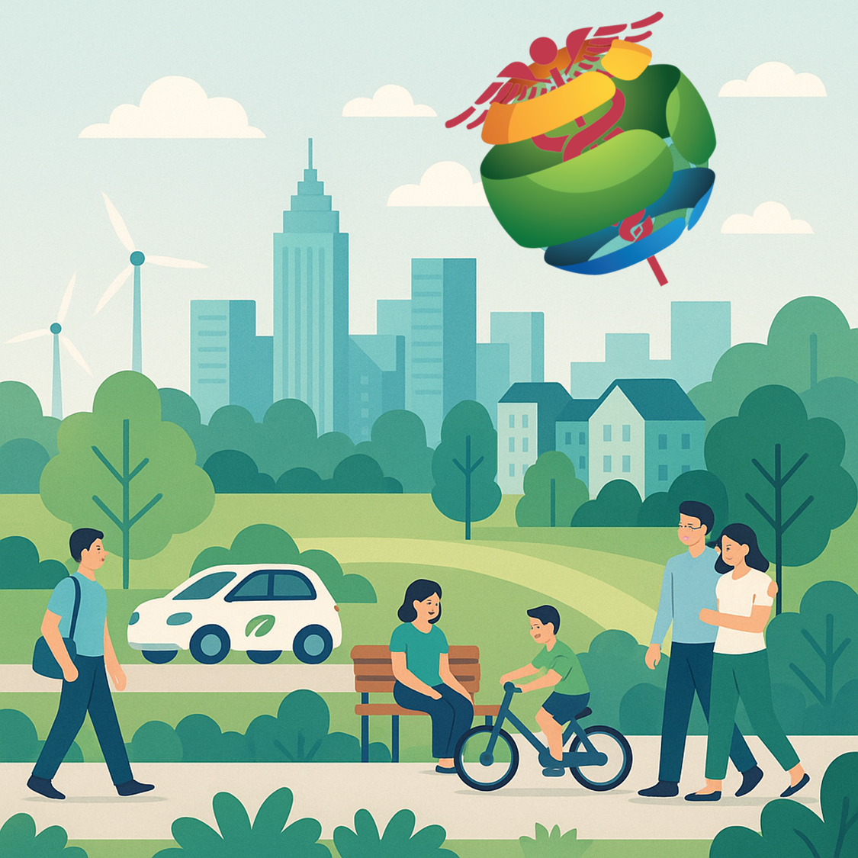
Key expected results
Real-World Validation
Urban Living Labs (ULLs): 10 case study cities testing interventions on pollution, waste, and health equity
Guidance & Indicators: New pollutant limit values, health impact indicators, and policy guidelines
Future Research & Collaboration
Robust datasets and pipelines reused in >20 research initiatives post-project
Validation of ENVESOME biomarkers by multiple EU institutes
Foundations for precision prevention, exposome-based risk assessment, and interdisciplinary collaboration across omics, AI, and urban health

Slide 12
Expected political and societal impact
Shaping Policy & Regulation
Evidence-based exposure thresholds to inform EU pollutant limit values
Decision-support tools for regulators & urban planners → healthier cities by design
Policy guidance addressing urban pollution, waste management, and health equity
Transforming Healthcare & Prevention
Integration of early-effect biomarkers into healthcare guidelines → earlier detection of exposure-driven NCD risks
Improved risk communication on environment–health links (air pollution, chemicals, noise, light, climate stressors)
Supports prevention strategies for:
Cardiovascular & respiratory diseases
Neurodevelopmental & neurodegenerative disorders
Metabolic syndrome & immune dysfunction
Sleep & mental health disturbances
Driving Societal Change
Empowers citizens with personalized coaching apps → healthier lifestyle & exposure reduction
Strengthens health equity, targeting vulnerable groups disproportionately affected by exposures
Enhances public awareness of the exposome, shifting behaviours and priorities toward sustainability
Direct Societal Challenges Addressed
✅ Urban environmental health risks ✅ Climate change & health inequalities ✅ Rising burden of non-communicable diseases (80% of EU’s disease burden)

Slide 13
https://envesome.eu/

