Slide 1


Translating research results into policy influence: lessons from the ground
Gerardo Sanchez
ExpoHealthNet
The Role of Environmental Pollution in Non-Communicable Disease
25-26 September 2025
Barcelona, Spain
© Teodora Koleva, Climate Change PIX /EEA
Notes:
OPENING SLIDE – dark background and white logo

Slide 2

The EEA is …
An independent EU agency
Based in Copenhagen
Analysing, assessing and providing information on the environment
An interface between science and policy
Dependent upon strong networks to carry out its work
Shares an acronym with the European Economic Area, but not much else
Notes:
We were set up by EEC Regulation 1210/1990 (amended by EC regulations 933/1999 and 1641/2003)
The decision to locate the Agency in Copenhagen was taken in 1993
We have been operational since 1994

Slide 3
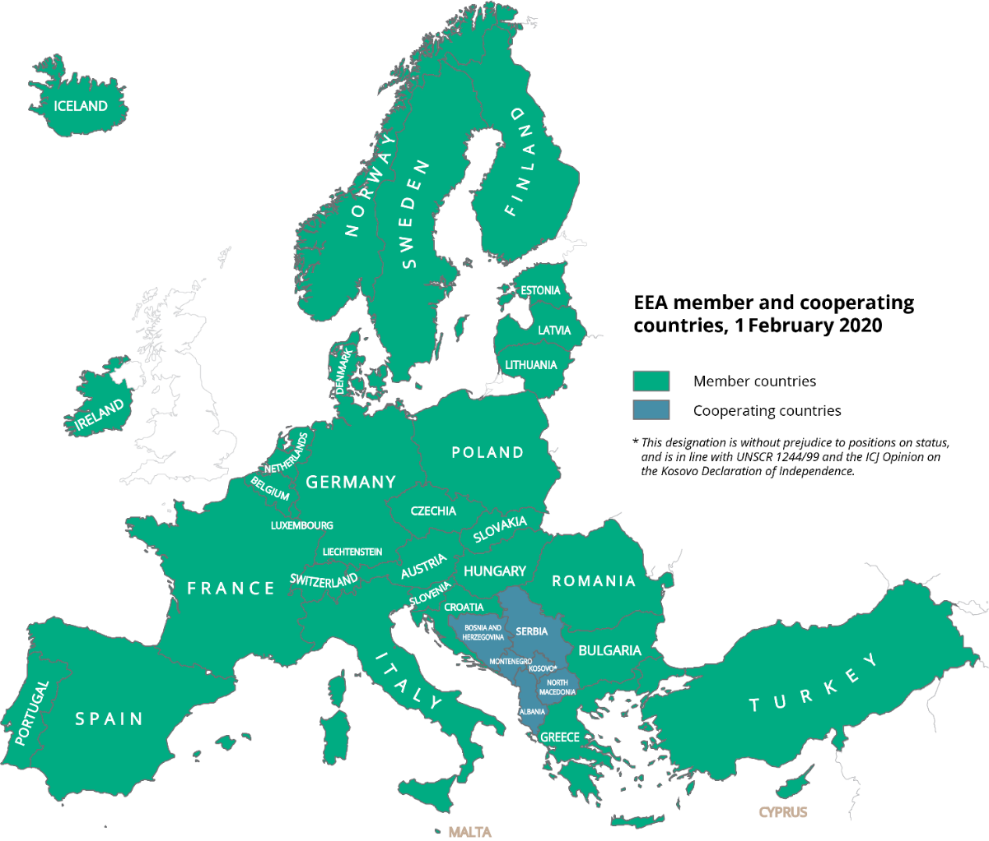
EEA member and cooperating countries
The EIONET network is comprised of:
2000+ experts
From over 400 national institutions
In 38 countries
Including 7 European Topic Centres
EIONET expert groups
…working together with EEA’s roughly 300 employees in Copenhagen
Notes:
Strong institutional cooperation across national, regional, European, and international levels and partnerships with civil society, facilitated by a coordinating entity
Agreed common content — data, information, indicators, analysis
Shared infrastructure, standards and tools.

Slide 4
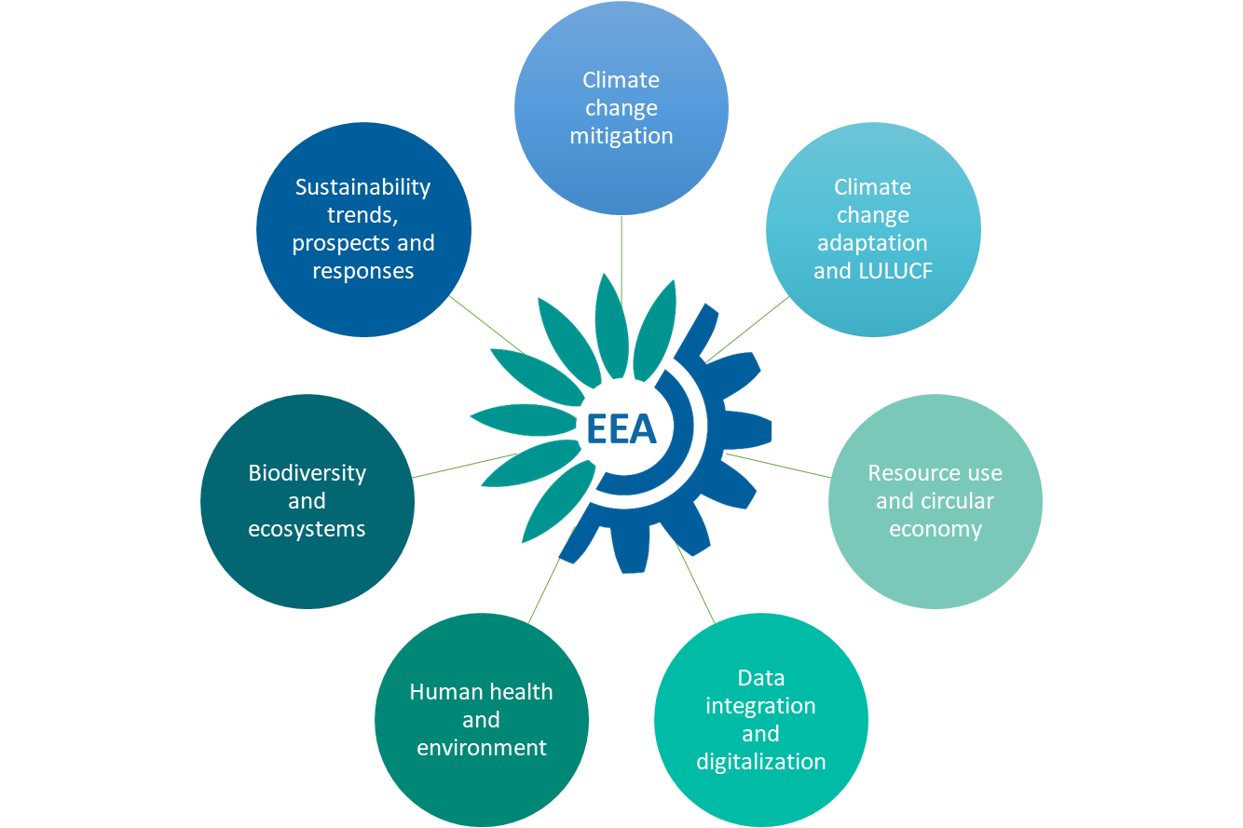
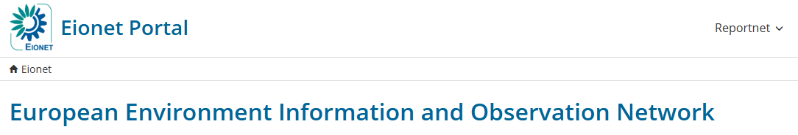
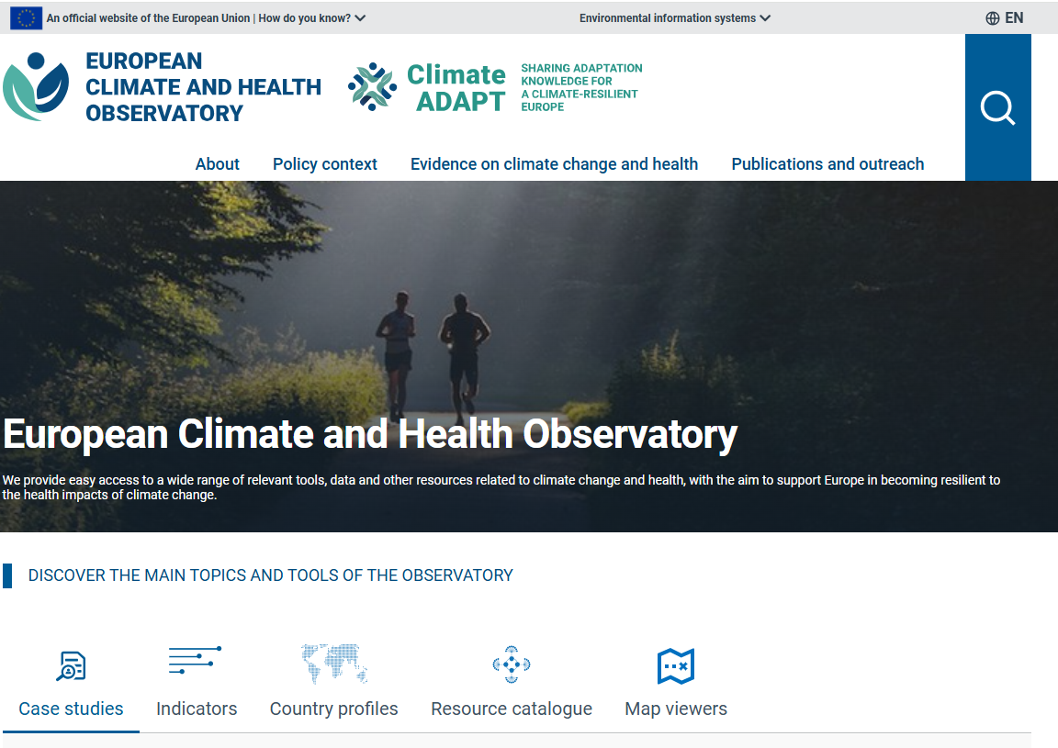
How do we work on environment and health?
1
2
EG Health and Environment
TG Air
TG Noise
TG Chemicals
EG Climate Change Adaptation
European topic centre on Health and the Environment
3

Slide 5


What recurring messages do we get on EU environmental policy?
Policy framework largely set, no appetite for additional large-scale regulations
Implementation is what’s needed; Challenges:
Resource and capacity constraints, particularly at subnational level
Difficult coordination multiple governance levels
Complexity and reporting burden
Political backlash
Integration of health and environment difficult in the practice (environmental institutions more proactive)
In this context, how can environment and health research projects and results matter in policy? (just a few ideas)
© Teodora Koleva, Climate Change PIX /EEA

Slide 6
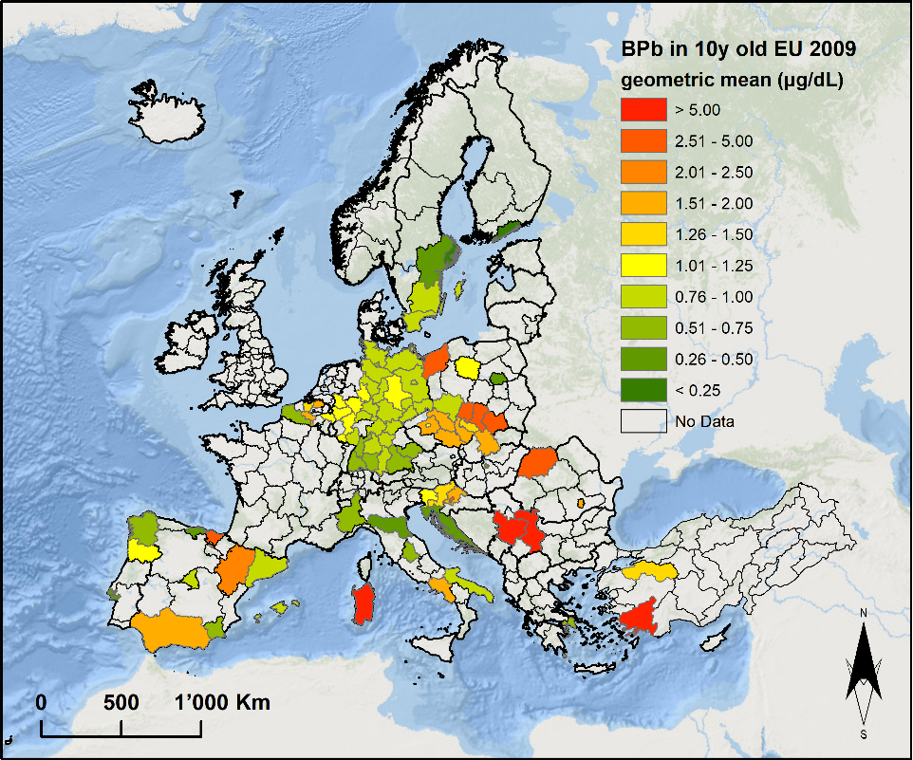
Local relevance: grey areas may not care much about your results
Source: ETC HE, courtesy of Dr Anton Beloconi, based on HBM4EU data

Slide 7
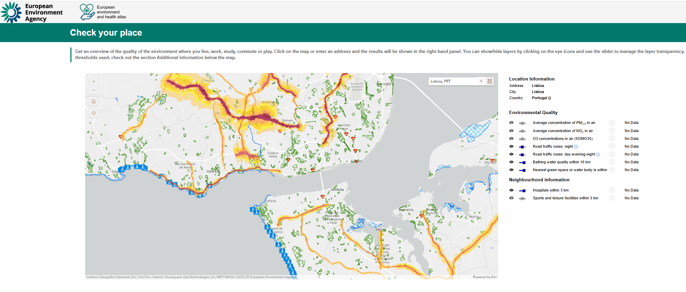

A surprising success of local relevance: the EEH Atlas
https://discomap.eea.europa.eu/atlas/

Slide 8
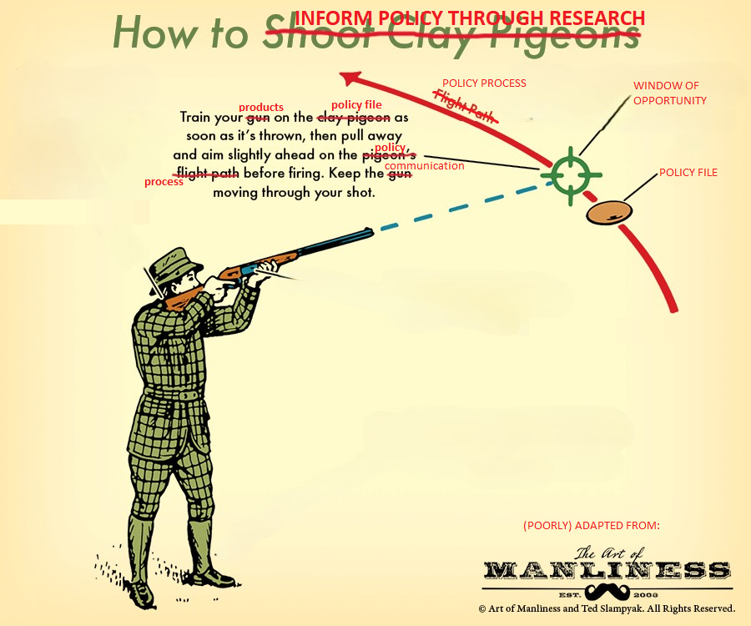
Timeliness
Not condoning shooting of any kind; but if you do, use non-lead ammo ☺
Source: adapted from https://www.artofmanliness.com/

Slide 9
Some upcoming files of interest
Title | Topic | Timeline | External | EC information
PFAS restriction | Chemicals | End 2026 | Keep in mind also: "Develop an EU-wide PFAS monitoring framework to centralise data as well as promote practical, science-based solutions for a sustainable shift by EU industry (Q4 2026).
REACH | Chemicals | Q4 2025
Industrial Decarbonisation Accelerator Act | Industry | Q4 2025 | ·Establish a low-carbon product label ·Apply sustainability, resilience and minimum EU content requirement in public and private procurement in strategic sectors to ensure lead markets for low-carbon products
EU Cardiovascular plan | Health | Q4 2025 |  | https://ec.europa.eu/info/law/better-regulation/have-your-say/initiatives/14755-EU-cardiovascular-health-plan_en
EU Biotech act | Industry;#Health;#Competitiveness | Q3 2026 |  | https://ec.europa.eu/info/law/better-regulation/have-your-say/initiatives/14627-Biotech-Act_en
Union prevention, preparedness, and response plan for health crises | Health;#Resilience | Q4 2025 |  | https://ec.europa.eu/info/law/better-regulation/have-your-say/initiatives/14777-Union-prevention-preparedness-and-response-plan-for-health-crises_en
Simplification of administrative burden in environmental legislation | Industry;#Competitiveness;#Simplification | Q4 2025 | The discontinuation of the SCIP Streamlining reporting obligations, removing double requirements to report, promoting further digitalisation of reporting in the area of circular economy, industrial emissions and waste management, while maintaining the policy objectives Addressing permitting challenges relating to environment assessments based on experience recently gained such as under the Net Zero Industry Act | https://ec.europa.eu/info/law/better-regulation/have-your-say/initiatives/14794-Simplification-of-administrative-burdens-in-environmental-legislation-_en
Lead restriction under REACH | Pollution;#Health | Vote Nov 2025 earliest, then goes to Council and EP for scrutiny | The proposal is being discussed in the REACH Committee. ENDS understands that the Commission has developed four options to move the proposal forward, and presented them to member states at a 26 June meeting. Member states are due to provide written comments by 21 August, after which the next discussion is scheduled for October, according to a summary of the meeting. ENDS understands that the committee is unlikely to hold a formal vote on the file until November at the earliest. Once approved, the proposals will be scrutinised by the EU Parliament and Council.

Slide 10
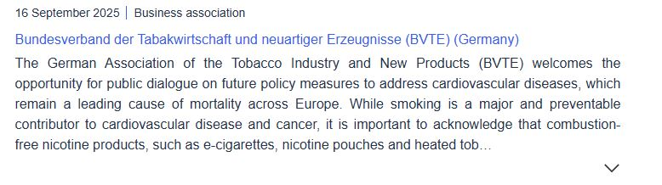
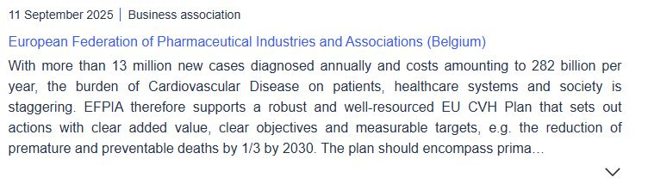
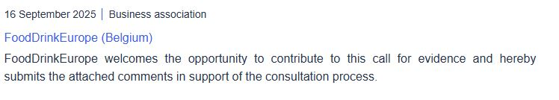
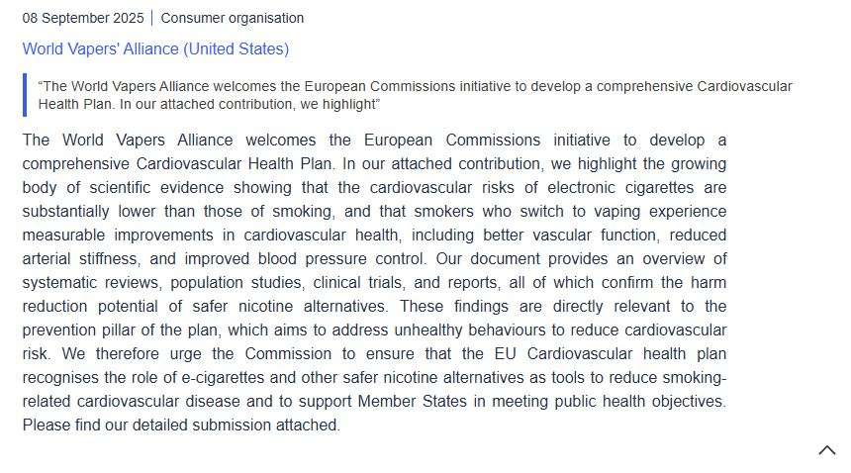
Speaking with one voice on the larger matters – using all chances
EXTRACTS FROM THE CALL FOR EVIDENCE ON THE UPCOMING EU CARDIOVASCULAR HEALTH PLAN; LOBBIES DON’T THINK CONTRIBUTING IS A WASTE OF TIME. HERE’S WHY.

Slide 11
Engagement with research projects at EEA at large
Current situation: fragmented and ad hoc engagement with EU-funded research
No systematic benefit for EEA/Eionet from EU-funded research
Research may or may not be picked up in reviews by ETCs, contractors or staff.
Some project leads reach out to EEA directly, occasionally leading to Eionet presentations.
No structured way for EU-funded research projects to benefit from EEA expertise
EEA staff are sometimes invited to advisory boards.
These invitations typically happen ad hoc, EEA staff expertise found via google or similar.
One board commitment limits ability to support other valuable projects.
Potential solutions
Cluster-level engagement: EU Agencies joining advisory boards of research clusters (5–8 projects), as encouraged by DG RTD.
Fair exposure: Clusters should be able to present to relevant Eionet groups, ensuring balanced visibility.
Policy relevance: Projects sometimes lack practical pathways to policy impact—EU agencies typically have one foot on science and the other on policy, and can provide useful guidance.
Strategic approach: EEA should develop a clear engagement strategy with research networks, starting with EU-funded ones. Our scientific committee is on board with this type of engagement, they’ve said it many times.
Model to follow: DG RTD’s Environment, Climate and Health team can help as an example - direct, effective nudging for engagement from the commission’s side.

Slide 12
Why using the One Health framework is a good idea to get attention
Joint EU Agency Framework
Five EU agencies (ECDC, EFSA, EMA, ECHA, EEA) launched a coordinated One Health action plan (2024–2026) focusing on strategic coordination, research, capacity building, stakeholder engagement, and joint activities.
Policy Integration by the European Commission
One Health principles are embedded in EU policies on antimicrobial resistance (AMR), zoonotic threats, and climate-related health risks.
Cross-Agency Collaboration
EU agencies collaborate on integrated surveillance, joint risk assessments, shared data platforms, and professional training to break down silos and improve health threat preparedness.
Major Funding Initiatives
The €253 million OHAMR Partnership (2025–2035) supports transnational AMR research and policy translation, building on over €1.18 billion in previous EU health research funding.
Strategic Embedding
One Health is now a core principle in major EU strategies, including the European Health Union, Farm to Fork, and Biodiversity Strategy to 2030.
AND IT IS STILL NOT CLEAR WHAT THE ENVIRONMENTAL ANGLE OF ONE HEALTH IS OR SHOULD BE:
Environmental issues affecting both animals and humans?
Infectious diseases and zoonoses influenced by the environment?
A well-marketed version of the exposome?
…?

Slide 13
IN SUMMARY
Locally tailored projects and results – locally relevant, engaging community, coverage
TIMELY injection of evidence through available channels
Leaving the ivory tower and speaking with one voice
One health is not only a useful buzzword, it’s starting to acquire meaning

Slide 14

Thanks for listening.
© Teodora Koleva, Climate Change PIX /EEA
Notes:
OPENING SLIDE – dark background and white logo

