Slide 1


Expohealthnet Cluster Decoding pollution, protecting health.
September 25th | Manosij Ghosh

Slide 2
Origins of the cluster
Horizon Europe topic HORIZON-HLTH-2024-ENVHLTH-02-06-two-stage “The role of environmental pollution in non-communicable diseases: air, noise and light and hazardous waste pollution” funded a total of 7 research projects.
Call opening date: 30 March 2023
First stage deadline: 19 September 2023
Second stage deadline: 11 April 2024
Objective of the cluster: Optimise synergies, avoid overlaps and increase the impact of the projects selected for funding.

Slide 3







Composition
7 projects. 104 organisations. More than 300 researchers.

Slide 4
Exposures
Air Pollution & Particulates
PM2.5, PM10, NO₂, O₃, black carbon, ultrafine particles (UFPs)
Airborne pollen, aeroallergens, micro/nano plastics (MNPs)
Hazardous waste: PFAS, PAHs, phthalates, microplastics, PCBs, dioxins, heavy metals
Occupational exposures (e.g., firefighters, waste workers)
Dietary contamination (heavy metals, endocrine disruptors)
Physical Stressors
Noise pollution (traffic, occupational, environmental)
Ambient light (UV, solar, luminosity)
Climate & Environment
Temperature extremes, humidity, heat spells, atmospheric pressure
Green/blue space access (proximity to natural environments)
Socio-economic status as modifying factor

Slide 5
Health Outcomes
Cardiovascular Diseases
Coronary artery disease, hypertension, stroke, metabolic syndrome
Respiratory Diseases
COPD, asthma, hypersensitivity pneumonitis, pediatric respiratory illness
Neurological & Cognitive Outcomes
Dementia, Alzheimer’s disease, neurodevelopmental alterations (autism, ADHD)
Cognitive decline, neurodegenerative disorders
Immune-Mediated & Developmental Diseases
Autoimmune disorders (RA, SLE, type 1 diabetes, systemic sclerosis)
Allergic diseases (atopic dermatitis, food allergies)
Fetal & perinatal outcomes: low birth weight, preterm birth, intrauterine growth restriction
Other Outcomes
Cancer, dermatological diseases, ocular diseases
Sleep disorders, mental health disorders

Slide 6
Biological Endpoints (Biochemical Changes)
Molecular & Cellular Pathways
Inflammation, oxidative stress, circadian disruption, metabolic changes
Epigenetic changes, transcriptomics, metabolomics, proteomics, multi-omics profiling
Blood and tissue biomarkers (e.g., stress hormones, cytokines, oxidative markers)
Disease-Specific Biomarkers
Cardiovascular: pulse wave velocity, HR variability, myocardial strain rate
Respiratory: exhaled nitric oxide, lung function measures
Dermatological: cytokines, autoantibodies, skin barrier proteins, DNA damage markers
Ocular: corneal thickness, intraocular pressure, tear film biomarkers
Immune & Developmental Endpoints
Immune markers (IgG, IgM, IgE, cytokines, vaccination response)
Microbiome and adaptive immune response in allergy patients
Developmental effects: placental studies, embryonic development models
Neurological Endpoints
Neuroinflammation, amyloid & tau markers, neuronal activity & morphology
Cognitive testing, EEG, behavioral changes in animal models

Slide 7
Timing
60 months activity: 1/01/2025 – 31/12/2029
Period | Timing | Coordination
1st period | Jan 2025 – Sep 2025 | Exposim / ClimAir
2nd period | Oct 2025 – Jun 2026 | ClimAir / Markopolo
3rd period | Jul 2026 – Mar 2027 | Markopolo / ENACT
4th period | Apr 2027- Dec 2027 | ENACT / ENVESOME
5th period | Jan 2028 – Sep 2028 | ENVESOME / EXPOSIGNALZ
6th period | Oct 2028 – Jun 2029 | EXPOSIGNALZ / UPRISE
7th period | Jul 2029 – Dec 2029 | UPRISE / EXPOSIM

Slide 8
Working groups

Slide 9
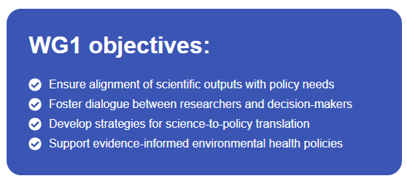
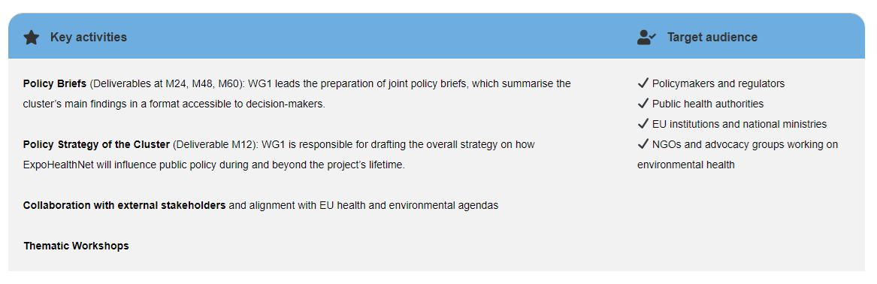
Working group 1
Science translation for policy and practice
Co-led by the MARKOPOLO and ENACT projects.

Slide 10
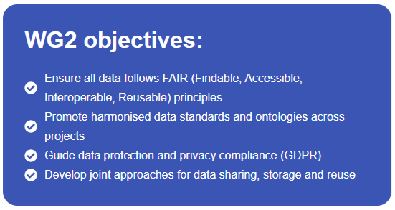
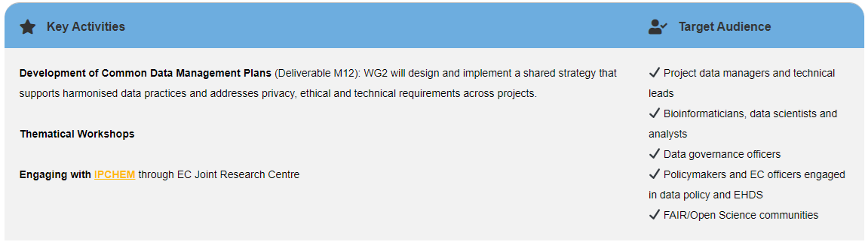
Working group 2
Data analysis, management and protection
Co-led by the ENVESOME and UPRISE projects.

Slide 11
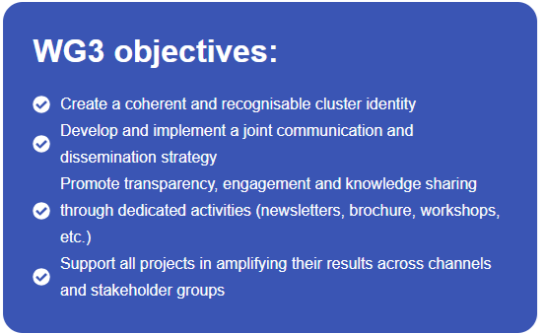
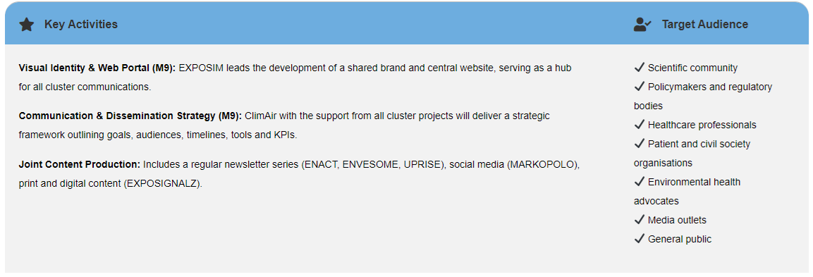
Working group 3
Communication and dissemination
Co-led by the EXPOSIM, ClimAIr and ExposignalZ projects.

Slide 12
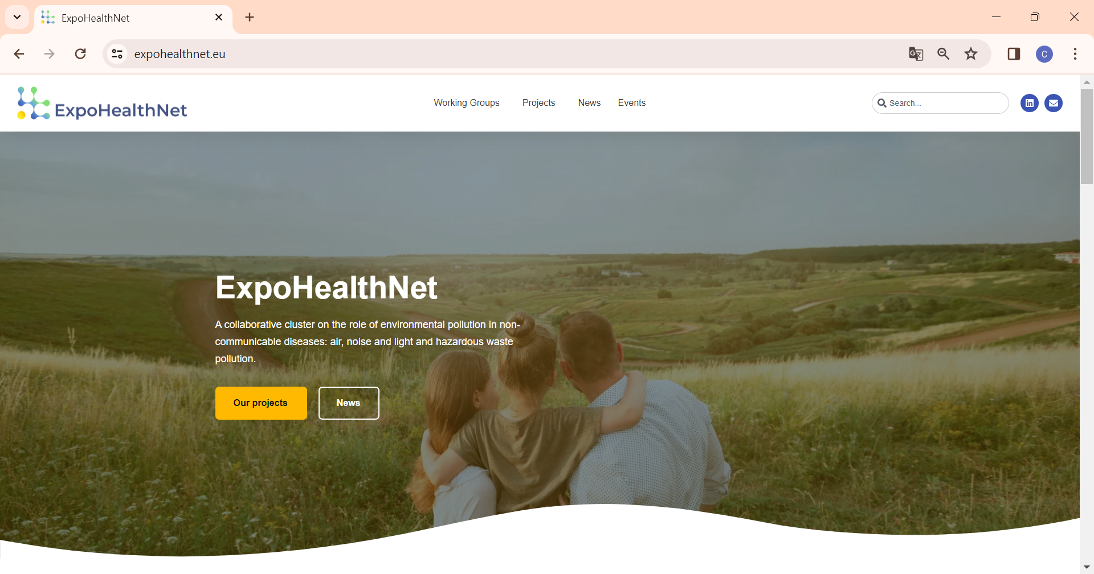




Staying tuned
https://expohealthnet.eu/
expohealthnet@gmail.com
ExpoHealthNet
Subscribe to our newsletter:

Slide 13
Thank you.

