Slide 1



EXPOSIM
Environmental stressors as causal determinants for immune-mediated diseases
September 25th,2025 | Peter Hoet, KU Leuven, Belgium

Slide 2
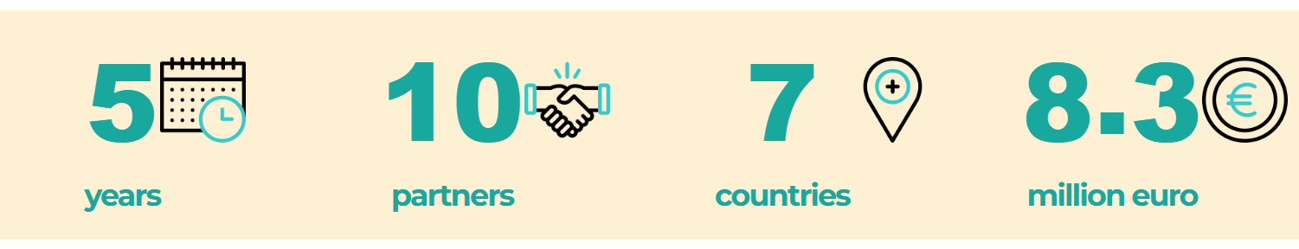
Environmental stressors as causal determinants for immune-mediated diseases.
Mapping and prioritising evidence for knowledge-based policy-making
EXPOSIM will provide a strong evidence base to better understand how combined environmental stressors – such as air pollution, noise, and hazardous waste – impact our immune health
Plus 6 ‘internal’
partners

Slide 3
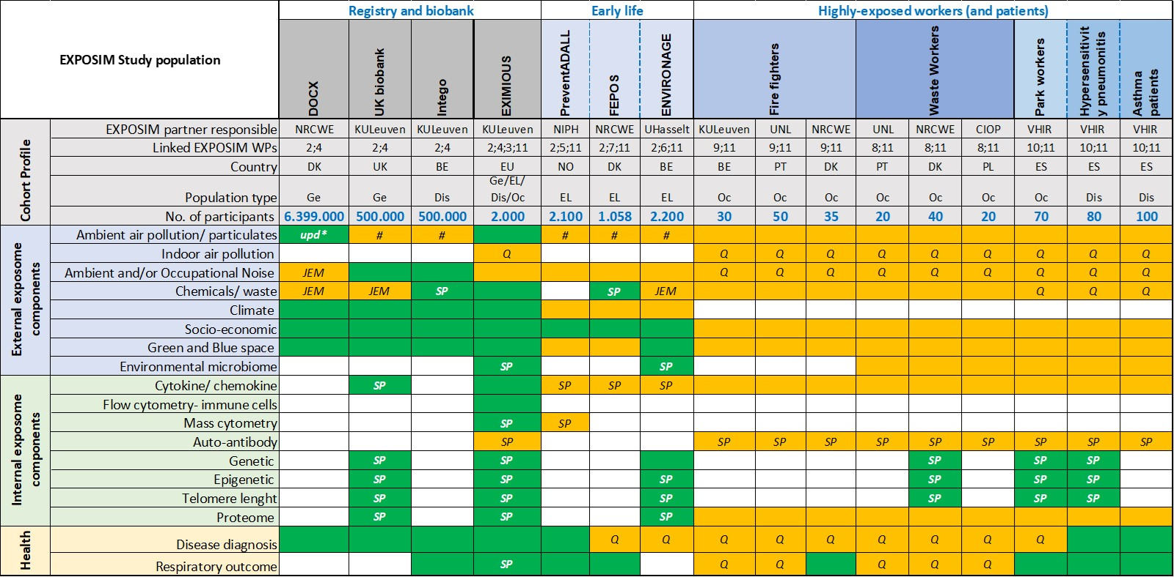
Scientific challenge and context
In-depth examination of exposures, health- and multi-omics- data

Slide 4


Scientific challenge and context
Immune remodelling & specific environmental stressors:
vulnerable populations e.g. early life exposure
highly exposed workers, e.g. firefighters, waste workers, …
Intervention studies to evaluate the effectiveness of exposure-reducing and health-promoting measures:
assessing existing policies and interventions
implementing early-life interventions to prevent allergic reactions
exploring technical, behavioural, and organizational interventions
Interventions build in co-creation

Slide 5
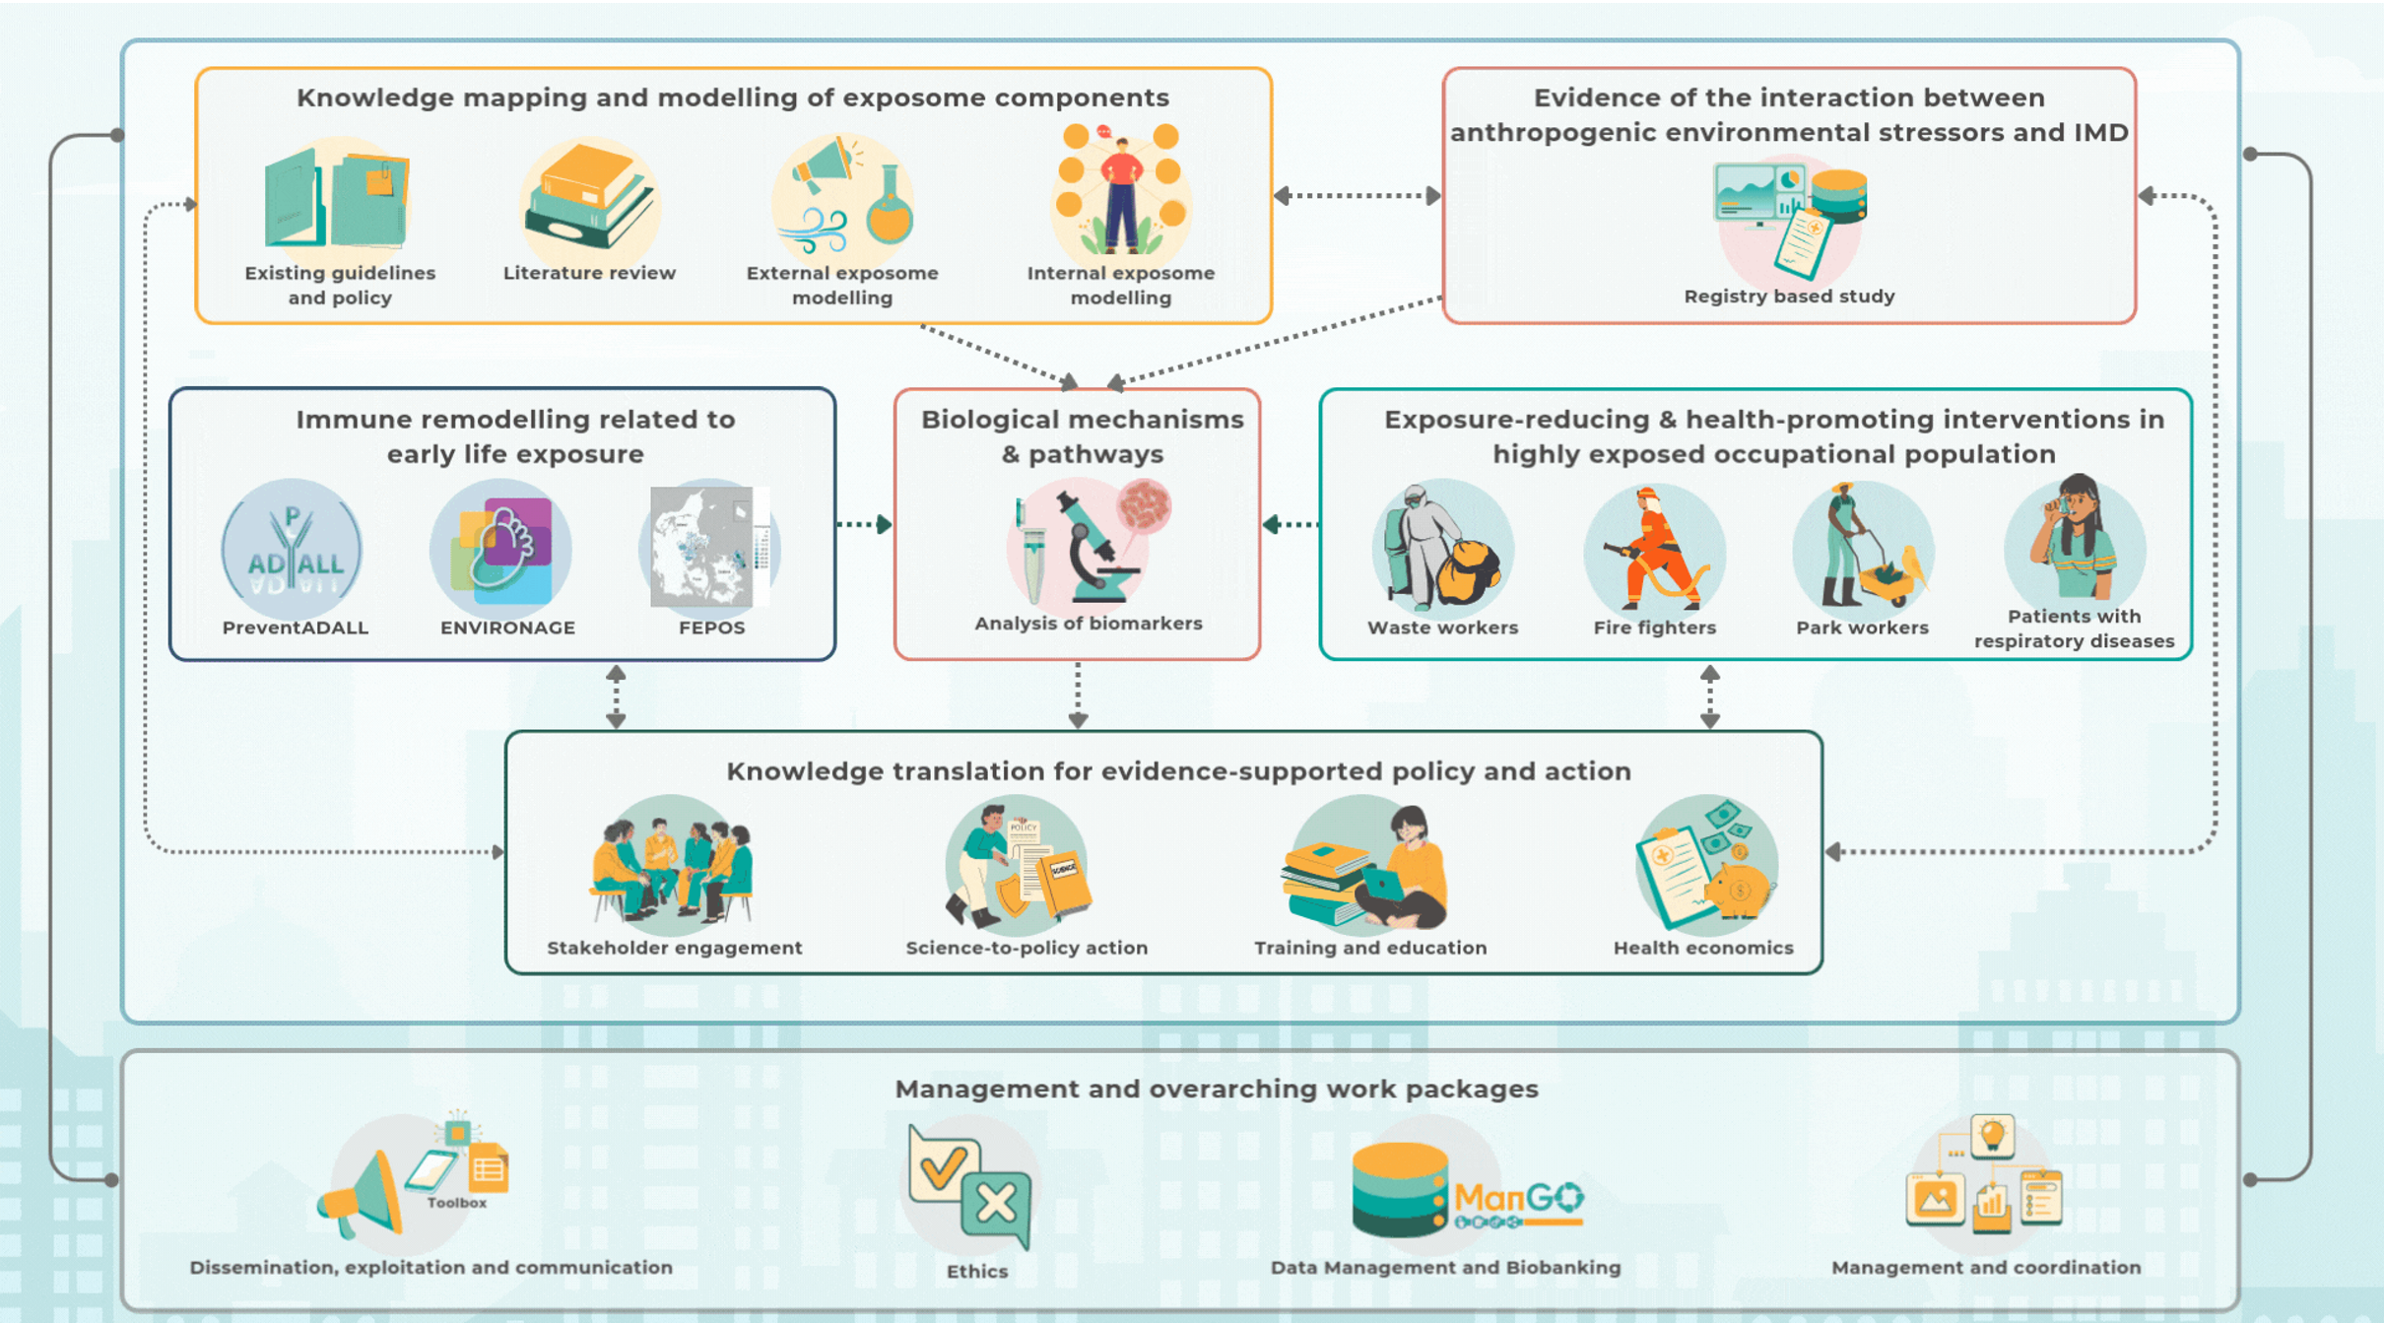
Scientific approach
Data mining & modelling existing data
Epidemiological/exposome studies
Stakeholders, policy, training
& H-economics
Dissemination and more

Slide 6
Key expected results
Scientific evidence health risks by environmental stressors
  exposome modelling
Better understanding risk of IMDs
exposure to environmental stressors and genotype
Elucidate biological pathways from exposure → disease
combined exposures
Health promotion and disease prevention
education, training and communication

Slide 7
Expected political and societal impact
Risk communication
  roadmap from knowledge creation to incorporation into regulatory frameworks
Health economics focus of EXPOSIM
  healthcare and societal cost of IMDs
  including long-term treatment
  formal and informal long-term care
  productivity loss
  + effects of interventions on paid work and productivity
User-friendly tools to produce and use data on the impact of pollutants on health

Slide 8


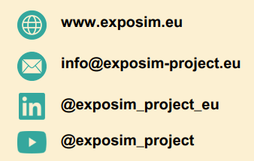




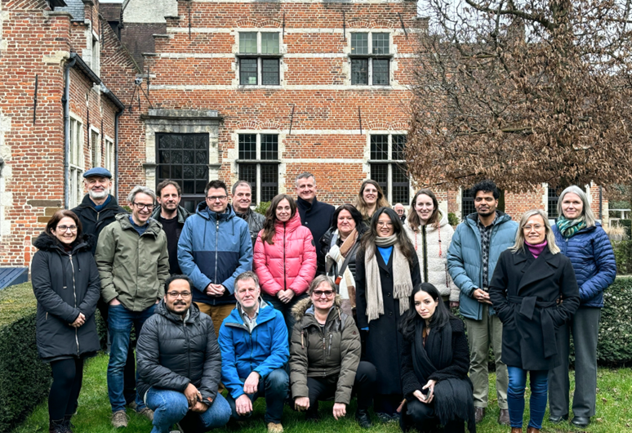





Slide 9
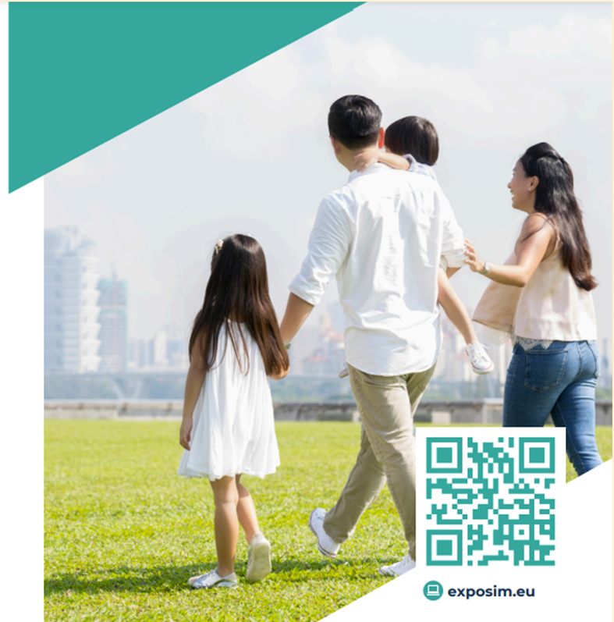


Thank You

Slide 10
