Slide 1




Climate change and air contamination: Artificial Intelligence applied on the correlation between air pollutants and non-communicable respiratory diseases in Europe
ClimAIr:
September 25th,2025 | Carlos Sánchez,

Slide 2
Scientific challenge and context
The Global Challenge: Air Pollution, Climate Change, and Respiratory Disease
Air pollution and climate change are linked to a rise in non-communicable diseases (NCDs), particularly respiratory illnesses.
WHO estimates air pollution contributes to 7 million deaths annually and millions of lost years of healthy life, primarily from NCDs.
Asthma affected an estimated 262 million people in 2019 and caused 455 000 deaths.
Allergic rhinitis affects more than 400 million people, with prevalence rates between 10% and 30% among adults and over 40% among children.
Climate change increase AP, elongates allergy seasons, increase pollen allergenicity, modify weather patterns and increase the frequency of extreme weather events.
Interactions between AP, Climate change and the combine effect multiple pollutants and emerging pollutants on human health remains under-explored.

Slide 3
Scientific challenge and context
ClimAIr’s Major Advancements
Mechanistic study to comprehend the biological mechanisms underlying.
Multi-pollutant assessment: Investigating the impact of emerging pollutants like ultrafine particulates and black carbon, and how they interact with traditional pollutants.
Land-use regression, Chemical Dispersion and AI-modelling to identify non-linear correlations and predict future health impacts.
Offering a IDSS tool to assist EU and national authorities, policymakers, and hospitals to diminish health impacts associated.
Design, Implementation and monitoring of tailored interventions that will provide evidence to develop guidelines, recommendations and key-insight.

Slide 4
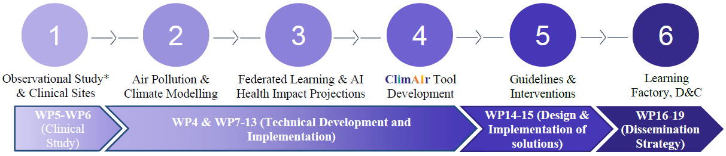
Scientific approach
Our Integrated Methodology
ClimAIr employs a interdisciplinary approach that combines clinical research, environmental modelling, and advanced AI, urban planning and a comprehensive dissemination strategy
9 medical centres, retro-prospective, 2000 patients
LES-SILAM simulations, 3D city models. NO2, O3, PM, SO2, Pollen, organics
Patient privacy-preserving Machine Learning across the 9 medical centres
IDSS, scenario simulations,
metrics,
intervention assesments
Evidence-based guidelines for mitigation
Professional training programs, engagement, exploitation

Slide 5
Key expected results
ClimAIr's research will generate tangible, impactful results for both the scientific and policy field:
Novel Scientific Evidence: We will identify and quantify the intricate correlations between specific pollutants and respiratory diseases, establishing a new scientific foundation for understanding these health threats.
Harmonised Environmental Datasets: We will produce a harmonised, high-resolution datasets of environmental information for our target cities (Berlin, Malaga, Milan, Thessaloniki, Brasov, Lodz, Chernivtsi, Toulouse, and the City of Luxembourg). This could serve as a resource for future research.
ClimAIr Tool: Our central output is a user-friendly, web-based Intelligent Decision Support System (IDSS). This tool will allow stakeholders to:
Forecast air pollution levels and health impacts.
Predict the incidence of respiratory diseases in specific areas.
Simulate the impact of hypothetical interventions, such as new regulations or green spaces.
Provide individual-level recommendations.
Access training courses and best-practice guidelines.
Evidence-Based Guidelines: We will develop a set of tailored guidelines and recommendations for policymakers, healthcare professionals, and urban planners on how to mitigate health impacts.
These results will enable other researchers to build upon our findings and will directly support interdisciplinary collaboration by providing a common set of validated tools and data.

Slide 6
Expected political and societal impact
Driving Policy and Public Health Forward
1) Influencing Real-World Decisions
ClimAIr's results will directly inform and empower key stakeholders to make impactful, evidence-based decisions:
For Policymakers: Our work will provide the scientific evidence to inform new environmental regulations, aligning with the EU's Zero-Pollution Action Plan. The ClimAIr tool will allow for direct simulation of policy effects before implementation.
For Healthcare: We will provide new insights and predictive tools to the medical field to better understand how environmental factors affect their patients, leading to more targeted prevention and treatment strategies for asthma and allergic rhinitis.
For Urban Planners: The ClimAIr tool will enable planners to design healthier, more resilient cities by demonstrating the direct health benefits of interventions like green infrastructure or traffic management.
2) Fostering Public Awareness and Resilience
The project's Learning Factory and communication strategy will translate complex scientific findings into accessible training courses and materials for citizens, educators, and professionals by . This will lead to:
A increase in the implementation of pollution mitigation strategies, lowering air pollution levels and related illnesses.
A increase in health knowledge related to air pollution and public engagement in pollution mitigation efforts.

Slide 7
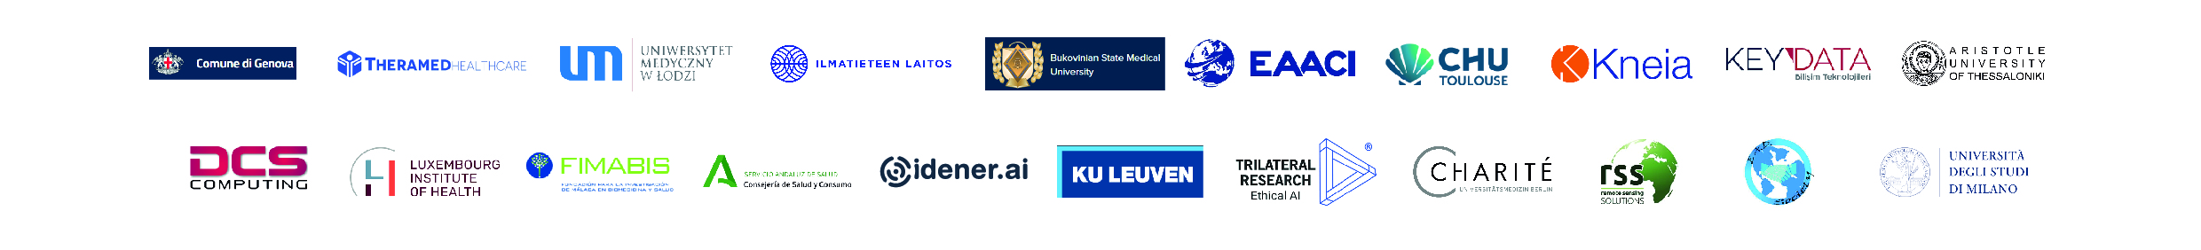
https://www.climair-project.eu/

