Slide 1



UPRISE Unravelling ultrafine particulate matter and micro nano plastic’s mechanisms of impact on fetal health
September 25th,2025 | Alba Ruiz Gaitán, Fundación para la Investigación del Hospital Politècnic i Universitari La Fe

Slide 2
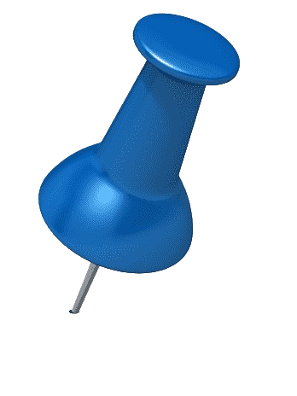










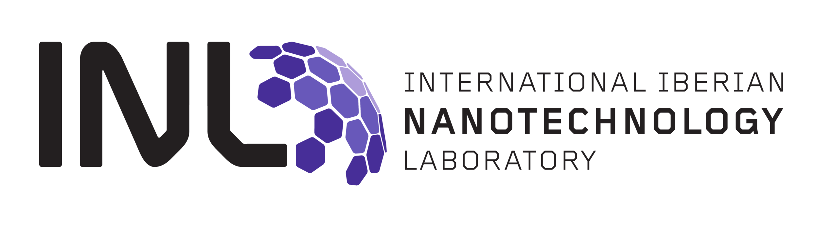


Scientific challenge and context
UPRISE aims to investigate how exposure to airborne Ultrafine Particles (UFPs) and Micro and Nano Plastics (MNPs) interferes the normal fetal development leading to a higher risk of preterm delivery. This, in turn predisposes individuals to a greater likelihood of developing non-communicable diseases (NCDs) later in their life.
It relies on the combined expertise of four fields:
- Environmental exposure (monitoring and modelling)
- Epidemiology
- Toxicology
- Health impact assessment
Its goal is to support evidence-based policymaking

Slide 3
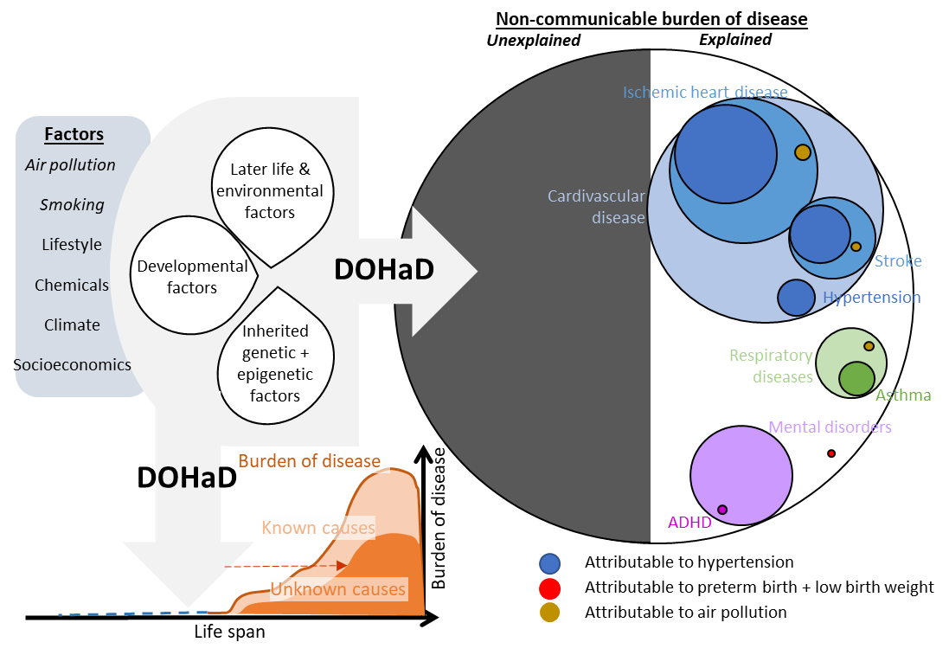
Scientific approach
Health impact assessment for exposure to UFPs and MNPs during pregnancy
Ultrafine
particles
and
inhaled
micronanoplastics
Next
Next
Next
Next
generation
generation
generation
generation
Birth
outcomes
Asthma
ADHD
Hypertension
Follow
Follow
-
-
up
up

Slide 4







Biological studies and identification of mechanisms of action
Objectives:
Analyse the potential mechanisms of action of the most abundant UFP and MNP particles detected
Determine the events that can culminate in adverse effects in the placenta
Understand placental translocation and effects of UFP and MNPs through in vitro studies
Quantitative detection and characterization of UFPs and MNPs in biological samples for the midterm cohort
Multi-omics analysis (epigenomics and transcriptomics) for the midterm cohort

Slide 5




Biological studies and identification of mechanisms of action
Goal: To identify potential mechanisms underlying ABO caused by placenta pathologies induced by exposure to UFPs and MNPs
Reviewing the events that can lead to adverse effects in the placenta following exposure to UFPs/MNPs, potentially contributing to ABO
Acquisition/production & characterization of environmentally relevant UFP/MNPs and targeted exposure studies in lung and placenta in vitro/ex vivo models
Collecting and analyzing evidence-based data for identified events across three scenarios:
Scenario 1
Mothers exposed to MNP/UFP
NO ABO
Scenario 2
No exposition to MNP/UFP
ABO
Scenario 3
Mothers exposed to MNP/UFP
ABO
ABO
ABO
ABO

Slide 6
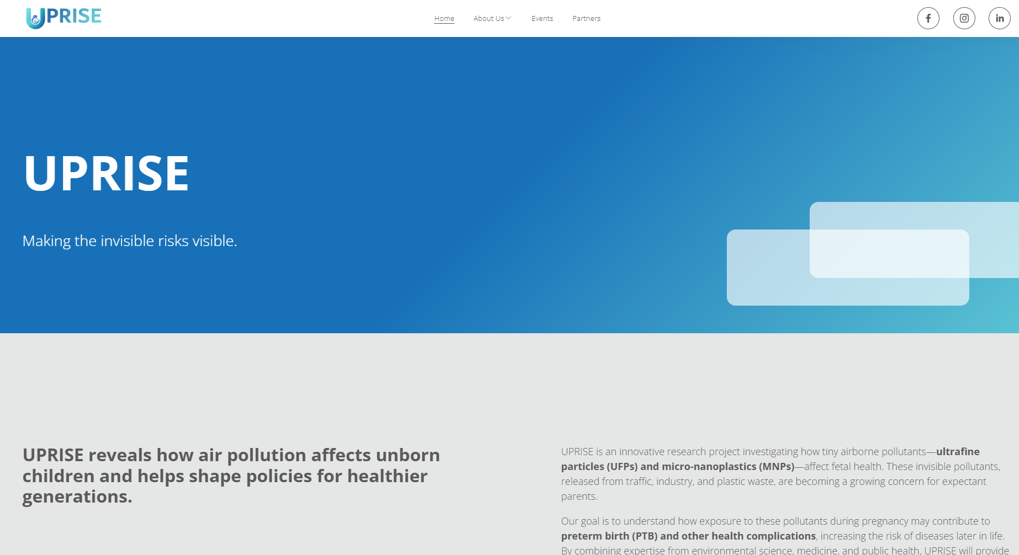
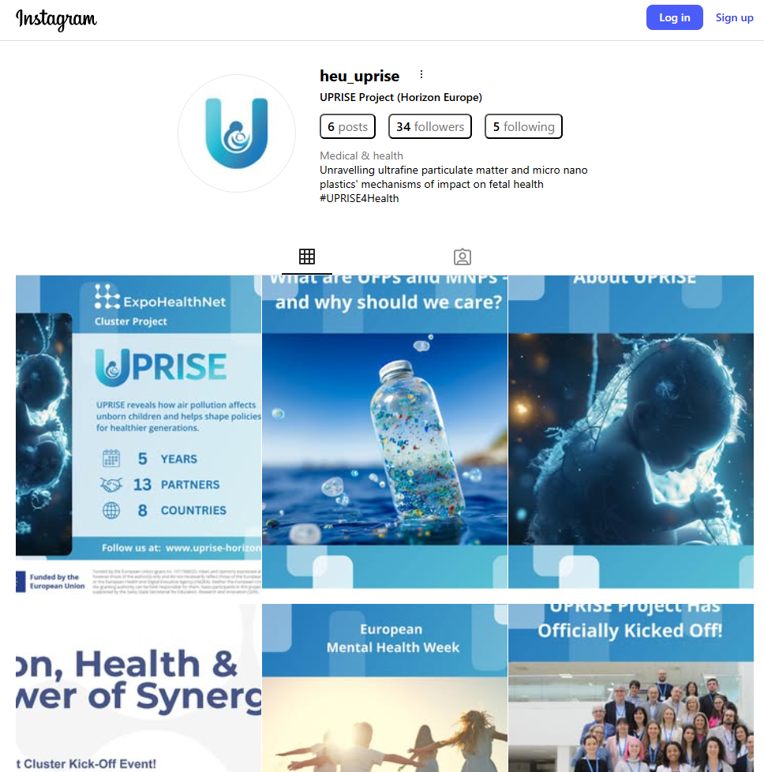

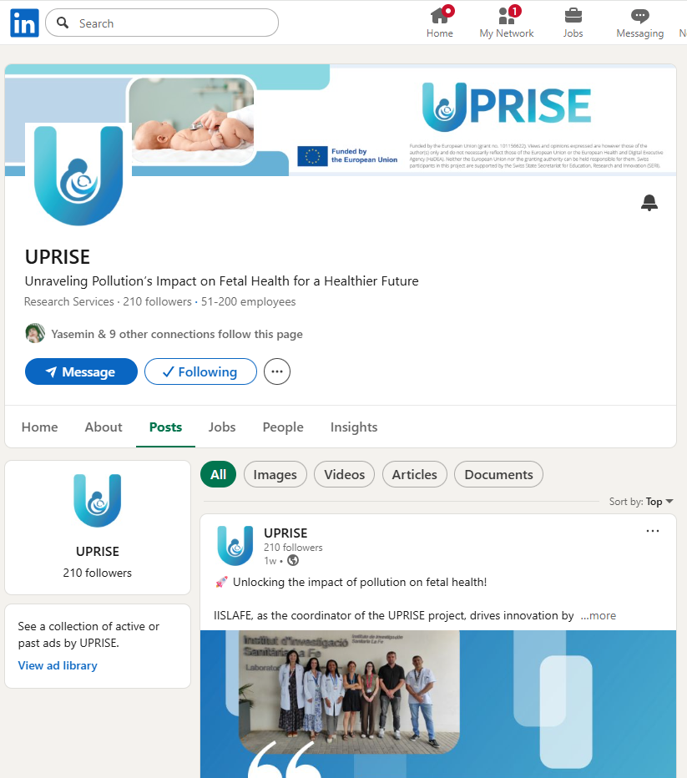
Expected political and societal impact
Stakeholder Engagement Programme to reach and engage multiple stakeholders groups:
Advisory board: interdisciplinary team of experts in public health, environmental policies and standardisation of MNP quantification from the EU and USA, together with representatives of local and regional authorities in environmental management.
Parent Advisory Board with lived experience of preterm birth
Interactive stakeholder workshops, events, and webinars
Engage in tool testing
Dissemination & Communication
Communicate the project to society through project identity and several channels
Ensure visibility of the outcomes
Develop and implement the PEDC
messages and channels adapted to target audience
to facilitate sharing of information
Training and capacity building
Development of two training courses; one for healthcare professionals and one for pregnant women and parents
web training tool-kit
5 technical workshops

Slide 7
Policy advocacy
UPRISE will generate robust scientific evidence to support the establishment of limit values for safe exposure to the targeted pollutants, thereby informing future EU-level directives and national regulatory frameworks to better protect public health.
By employing advanced air quality models to accurately identify emission sources, UPRISE will provide actionable insights to guide policy measures focused on emission reduction and pollutant concentration mitigation, ultimately contributing to lower population exposure and reduced health risks.

Slide 8

https://www.uprise-horizon.eu/

