Slide 1




EXPOSIGNALZ
Dissecting Brain Pollutant Exposure and its Contribution to Neurodegeneration and Alzheimer’s Disease:
From Signatures to Prevention Strategies to Protect and Maintain a Healthy Brain
https://www.exposignalz.com/
September 25th,2025 | Véronique Perrier, INSERM, Montpellier Institute of Neurosciences

Slide 2

Scientific challenge and context
Alzheimer’s disease
7th leading cause of death in the world
In 2019
57 million people affected by dementia worldwide
By 2050
152 million cases
60-70% Alzheimer’s patients
Disease modifying treatment approved by FDA in 2023 in USA and by EMA in 2024
Dementia prevention, intervention and care: 2024 Report of the Lancet Commission
Livingston G. et al. (2024) Lancet PMID: 39096926

Slide 3
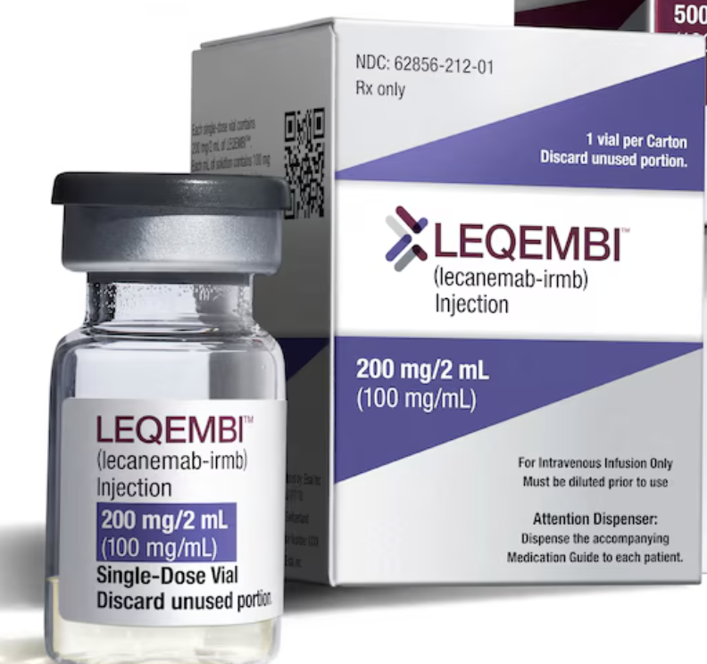
Scientific challenge and context
Alzheimer’s disease
7th leading cause of death in the world
Dementia prevention, intervention and care: 2024 Report of the Lancet Commission
Livingston G. et al. (2024) Lancet PMID: 39096926
In 2019
57 million people affected by dementia worldwide
By 2050
152 million cases
60-70% Alzheimer’s patients
Disease modifying treatment approved by FDA in 2023 in USA and by EMA in 2024
Patients in MCI stage in Europe
- theoretical eligibility 5.4 million
- adjusted 4.6- 4.9 million (exclusion Apoε4/Apoε4)
- real life 10-30 % of MCI patients 0.5- 1.6 million
The affordability of Lecanemab
Jönsson L. et al., (2023) The Lancet Reg. Heath Eur , PMID: 37251789

Slide 4
Scientific challenge and context
1
2
3
Develop prevention strategies
Identify new
risk factors
Prevent or delay disease onset
Dementia prevention, intervention and care: 2024 Report of the Lancet Commission
Livingston G. et al. (2024) Lancet PMID: 39096926

Slide 5
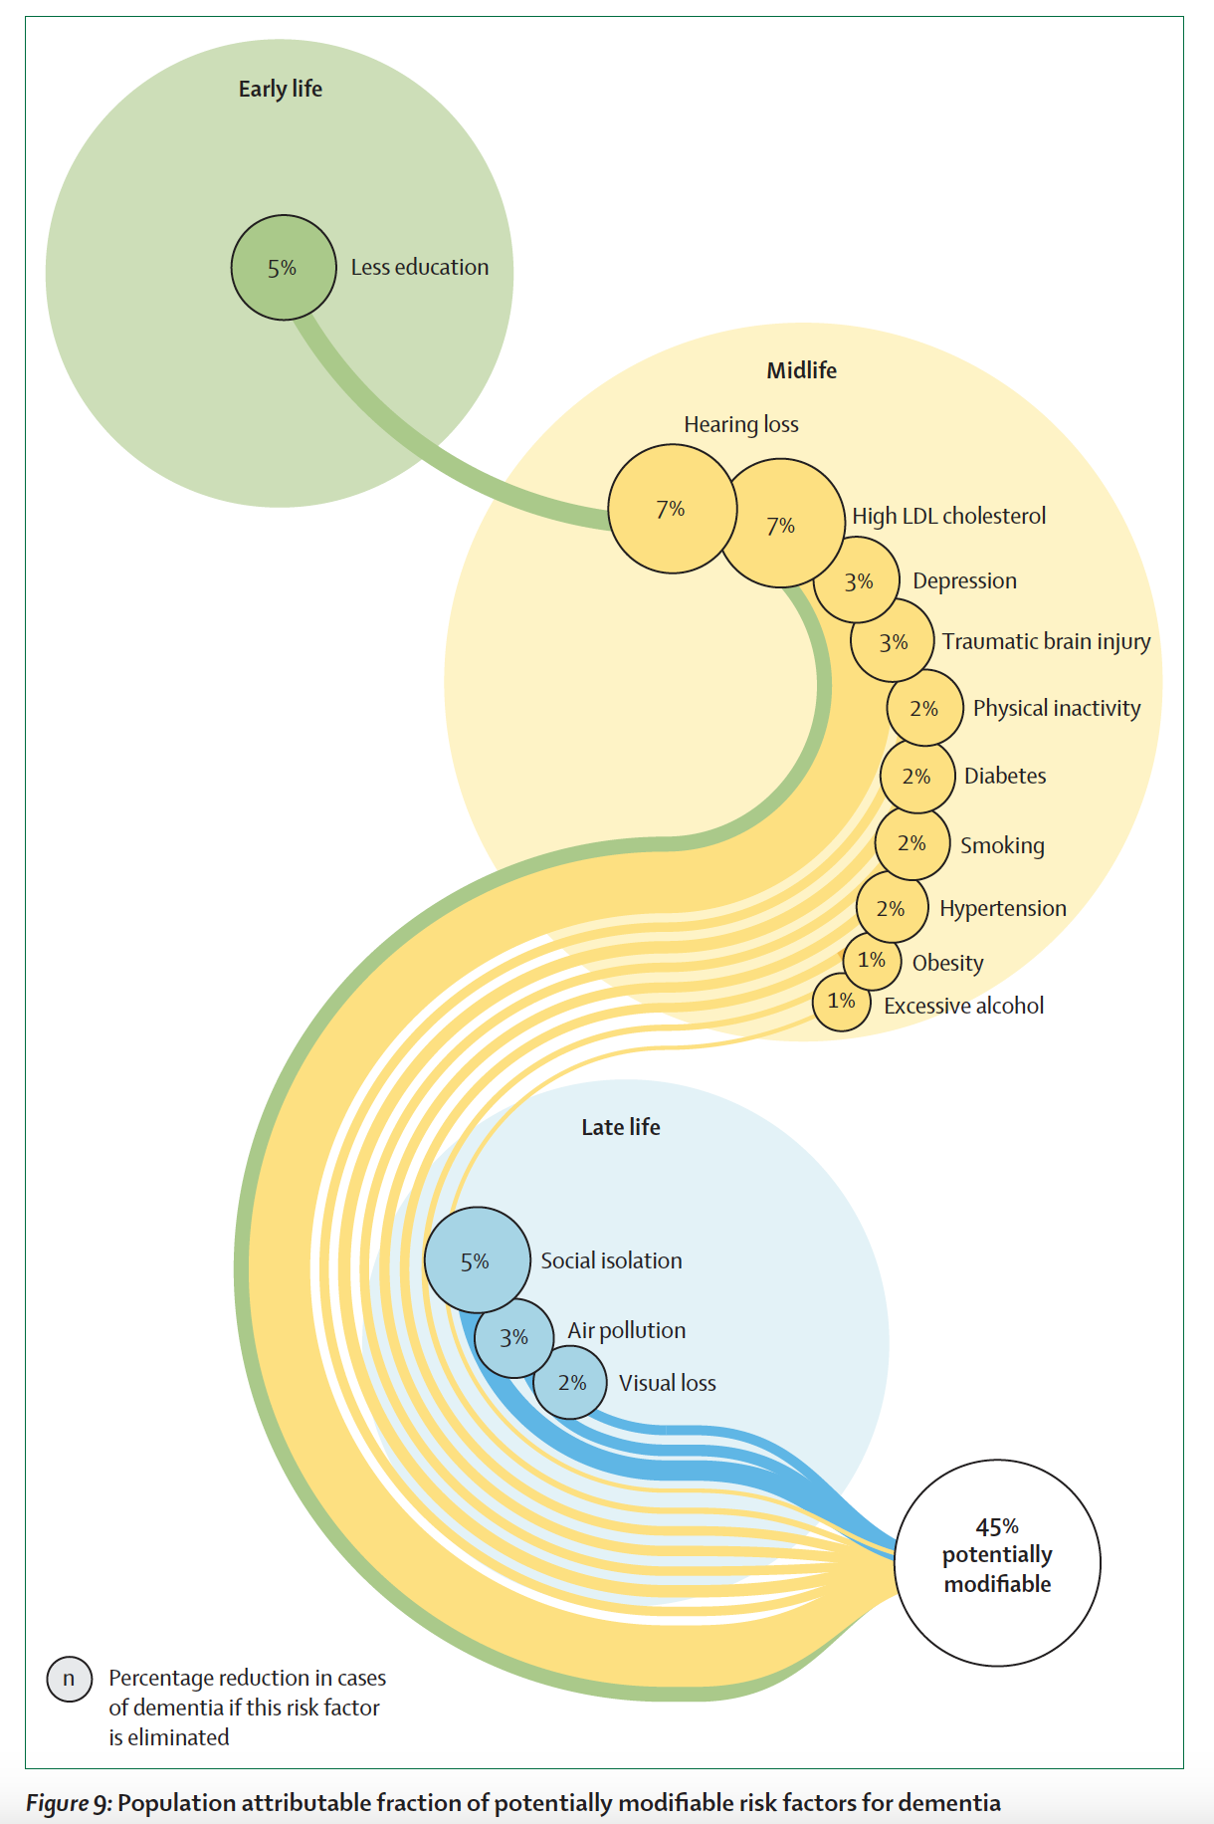
Scientific challenge and context
1
2
3
Develop prevention strategies
Identify new
risk factors
Prevent or delay disease onset
55% of risk factors remain to be identified
Modifying 14 risk factors might prevent or delay 45% of dementia cases (without genetic risk factor)
Air pollution accounts for 3% of Alzheimer’s cases
Dementia prevention, intervention and care: 2024 Report of the Lancet Commission
Livingston G. et al. (2024) Lancet PMID: 39096926

Slide 6
Scientific challenge and context
1
2
3
Develop prevention strategies
Identify new risk factors
Prevent or delay disease onset
55% of risk factors remain to be identified
Modifying 14 risk factors might prevent or delay 45% of dementia cases (without genetic risk factor)
Air pollution accounts for 3% of Alzheimer’s cases
How about other pollutants?
Role of pesticides in Alzheimer’s pathophysiology?
Chemical exposome? New risk factors?
Dementia prevention, intervention and care: 2024 Report of the Lancet Commission
Livingston G. et al. (2024) Lancet PMID: 39096926

Slide 7
Scientific approach
The Exposignalz project aims to uncover how specific chemical pollutants affect brain ageing and contribute to Alzheimer’s disease and cognitive decline.

Slide 8
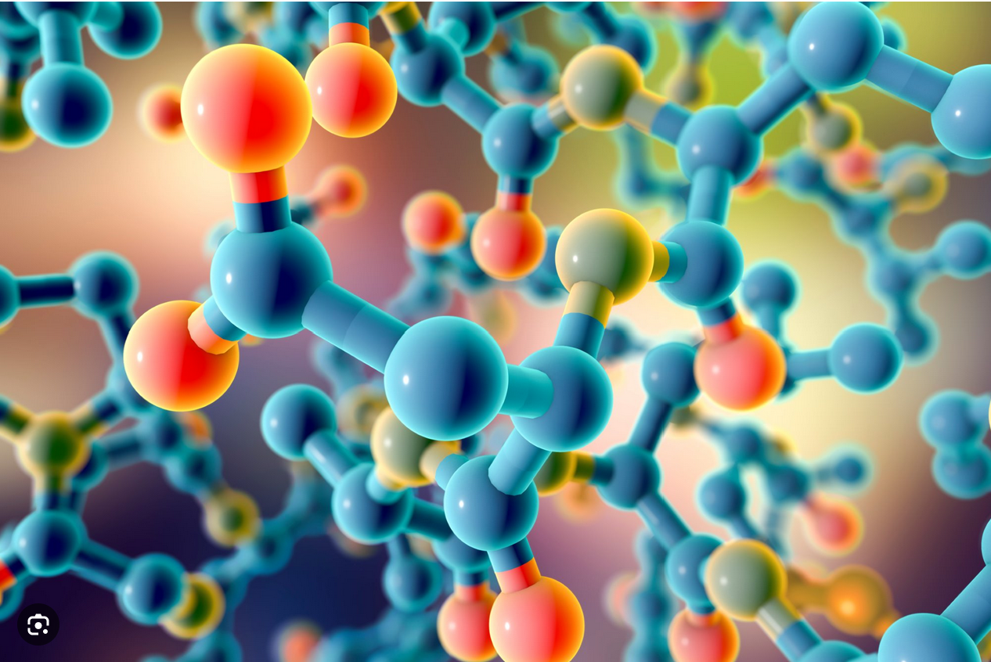
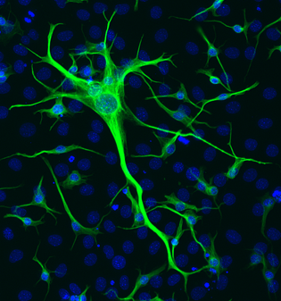
Scientific approach
The Exposignalz project aims to uncover how specific chemical pollutants affect brain ageing and contribute to Alzheimer ‘s disease and cognitive decline.
OBJ1: 3 partners
Identify environmental pollutants likely to have neurotoxic effects and
pro-amyloidogenic properties, potentially contributing to a neurodegenerative trajectory related to Alzheimer's disease.
67 selected pollutants to screen:
Persistant organic pollutants (POPs), e-Waste, substances in water, pharmaceutical residues, pesticides, anilinopyrimidine fungicides

Slide 9
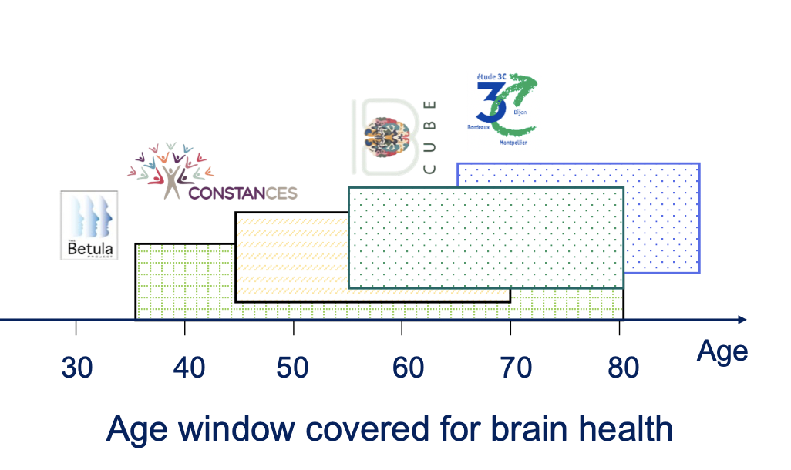
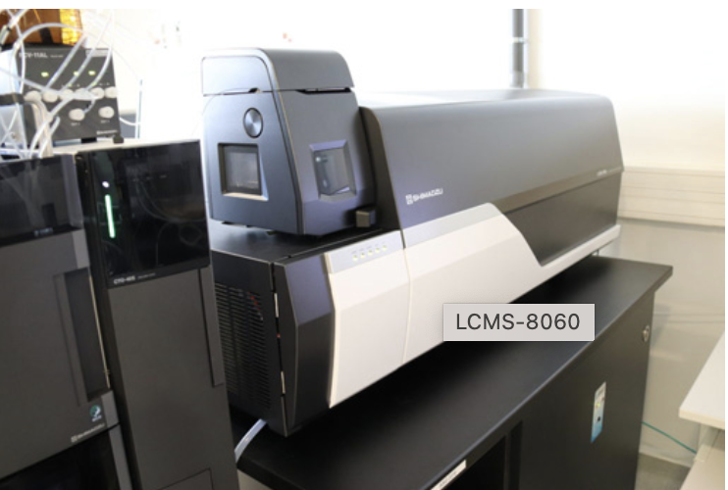
Scientific approach
The Exposignalz project aims to uncover how specific chemical pollutants affect brain ageing and contribute to Alzheimer ‘s disease and cognitive decline.
OBJ1: 3 partners
OBJ2: 6 partners
Identify environmental pollutants likely to have neurotoxic effects and
pro-amyloidogenic properties, potentially contributing to a neurodegenerative trajectory related to Alzheimer's disease.
Characterisation of pollutant signatures associated with brain ageing, cognitive decline and Alzheimer’s disease in the human population.
67 selected pollutants to screen
POPs, e-Waste, substance in water, pharmaceutical residues, pesticides, anilinopyrimidine fungicides
Chemical exposome in blood, urine and hair
4 human cohorts, 2 mass spectrometry platforms, 9,800 samples to screen

Slide 10
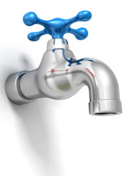


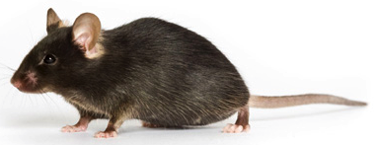
Scientific approach
OBJ3: 2 partners
Understand the mechanism of action of chemical signatures identified (OBJ1-OBJ2) in various Alzheimer’s disease models.
Cellular and preclinical AD models
2D and 3D network derived from AD-iPSC
2 preclinical models, behavioral studies, AD markers
Pollutant mixtures tested in animal models
D2
D3

Slide 11
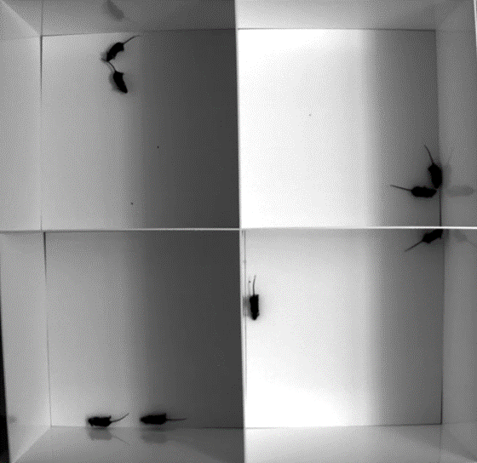
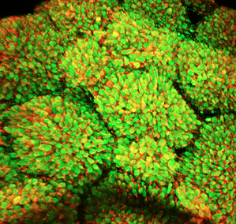
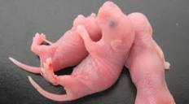
Scientific approach
OBJ3 : 2 partners
OBJ4 : 3 partners
Understand the mechanism of action of chemical signatures identified (OBJ1-OBJ2) in various Alzheimer’s disease models.
How chemical signatures identified impact early brain development as a susceptibility factor for neurodegenerative diseases
later in life?
Cellular and preclinical AD models
2D and 3D network derived from AD-iPSC
2 preclinical models, behavioural studies, AD markers
WT models
Brain organoids and maternal models of contamination, early development to ageing stages
Pollutant mixtures tested in animal models
D2
D3

Slide 12
Key expected results
Ranking of environmental pollutants based on amyloidogenic properties, neuronal network disruption, neurotoxic effects, impact on cell viability and blood brain barrier (BBB) integrity
Assessment of environmental chemicals in human biological matrices (blood, urine and hair)
Identification of distinct chemical signatures associated with cognitive decline, subclinical Alzheimer’s disease or incident Alzheimer’s disease
Results investigating the mechanism of action of pollutants signatures in Alzheimer’s disease models
Report the effect of chemical signatures on neurodevelopment and brain ageing: challenging the Developmental Origins of Health And Disease (DOHaD) concept
Identify environmental chemicals as new modifiable risk factors for dementia incidence

Slide 13


Expected political and societal impact
Dissemination of knowledge to scientific communities, specialised public, general public and governance
Dissemination of knowledge to policymakers and regulators
Proposition of prevention strategies for healthy brain development and healthy brain ageing
Proposition of guidelines based on relevant and robust data
Identify sources, high-exposure groups and vulnerable groups
Prevention strategy to delay the entrance of patients into the more severe stages of pathology
Reduce or delay the incidence of Alzheimer’s disease and thus reduce the economic and social burden on societies
Earlier diagnosis of Alzheimer’s disease combined with preventative interventions through enhanced understanding of pollutants and their effects.
1 Agency
Beta Technology

Slide 14




https://www.exposignalz.com/
Follow ExpoSignalz

