Slide 1



MARKOPOLO Noise and/or ultrafine particulate matter induced cerebral and cardiovascular damage: novel insights from experimental and epidemiological brain-heart axis biomarkers and computational models
September 25th,2025 | Andreas Daiber, UMC-Mainz

Slide 2
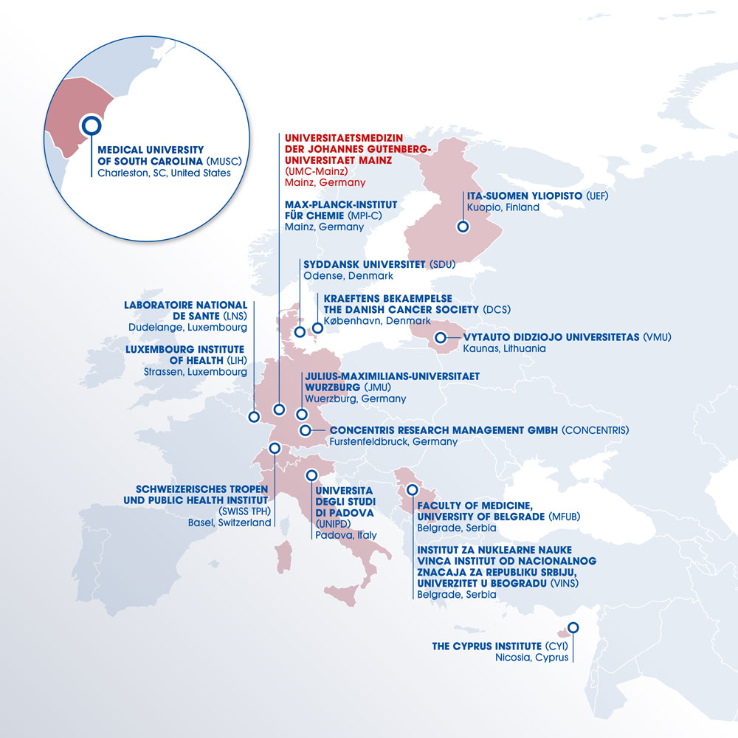

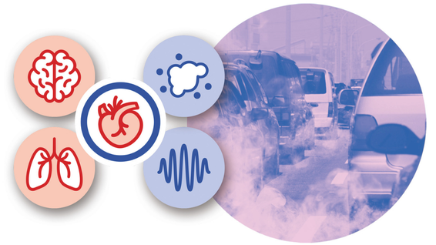

MARKOPOLO - Noise and/or ultrafine particulate matter induced cerebral and cardiovascular damage: novel insights from experimental and epidemiological brain-heart axis biomarkers and computational models
START DATE 01st January 2025
DURATION: 4 years
MEMBERS: 15 institutions from 10 countries
EU GRANT AMOUNT: 7.99 million Euro
SWISS GRANT AMOUNT: 1.28 million Euro
COORDINATOR: Prof. Andreas Daiber (UMC-Mainz)
Stay connected!
MORE INFO: www.markersofpollution-markopolo.eu

Slide 3
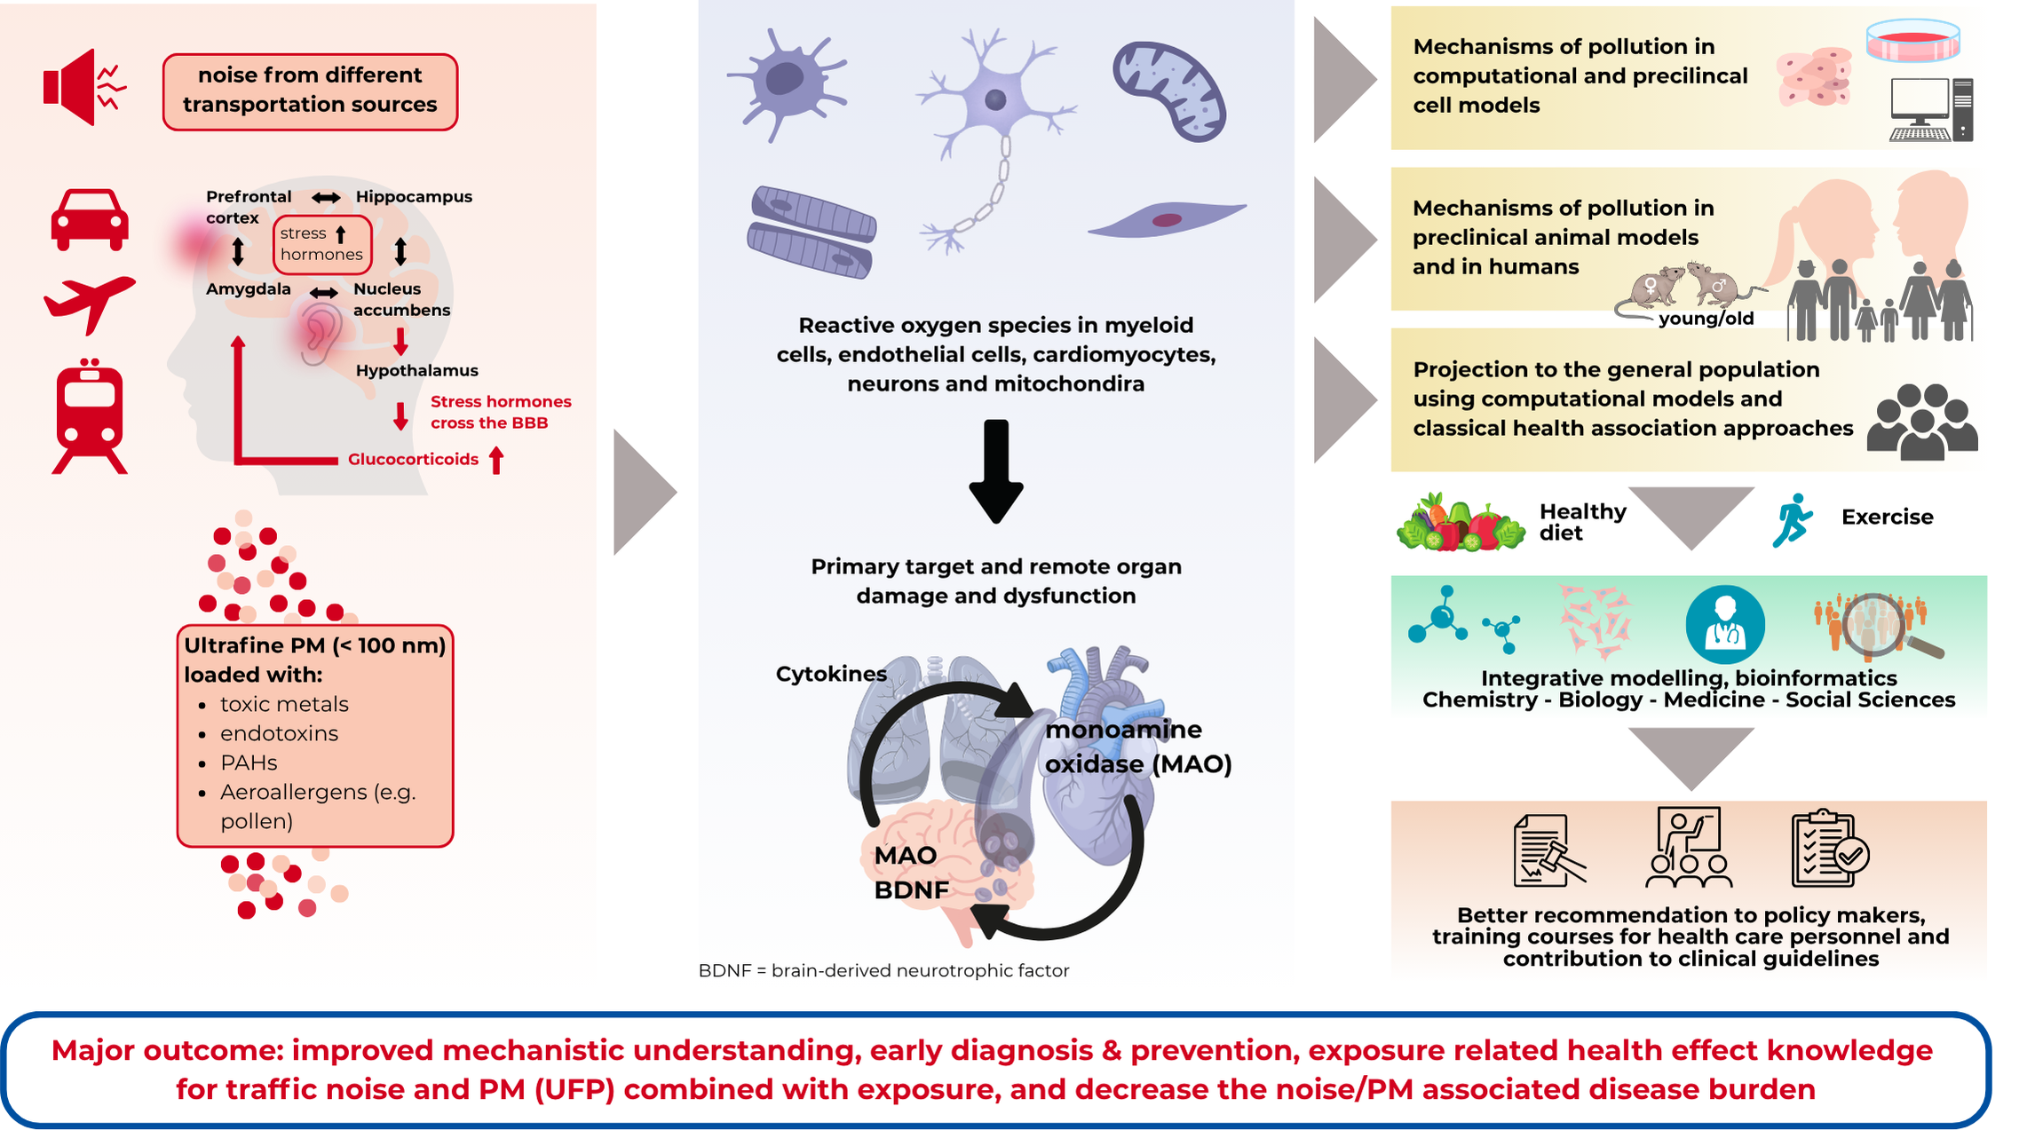
Scientific challenge and context
Social sciences framework analysis of knowledge transfer processes from science to policy/decision makers in different political contexts (all partner sites and different stakeholders involved)

Slide 4
Current knowledge gaps
MARKOPOLO will address critical health and societal issues, aiming to make significant wider impacts.
We identified these current knowledge gaps:
The lack of attention to traffic noise in clinical guidelines and legal sound pressure limits that exceed safe levels;
Legal exposure limits for ultrafine particles need to be defined based on their potential to cause adverse health effects;
The combined effects of PM and noise are largely ignored, despite evidence of additive harm;
Limited understanding of ultrafine particle (UFP) exposure and its harmful effects, including potential effects on the brain;
Limited research on the brain-heart axis despite its relevance to noise/PM health effects. Most studies focus on cardiovascular, respiratory, neurodegenerative, and mental diseases separately rather than their interconnected impacts;
Insufficient experimental in vivo research to better understand preventable pathways;
Limited knowledge of noise/PM effects on vulnerable groups;
Limited action and consideration of knowledge transfer and success metrics.

Slide 5
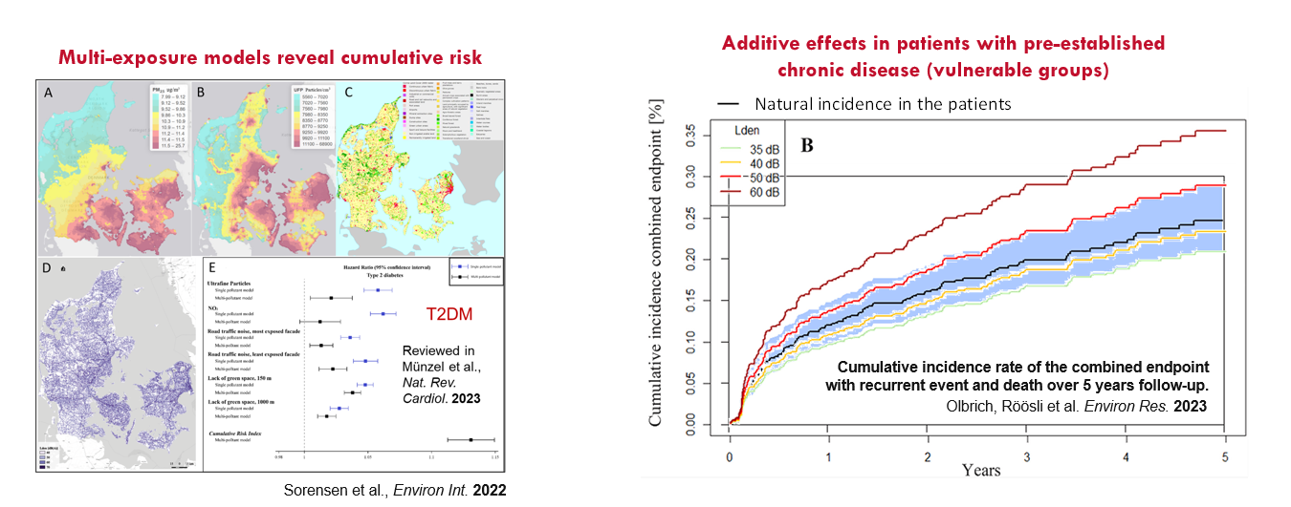
MARKOPOLO addresses unmet needs

Slide 6
MARKOPOLO addresses unmet needs

Slide 7
Scientific approach
Traffic noise and air pollution, especially particulate matter (PM) and ultrafine particles (UFP), are closely linked environmental risk factors that contribute significantly to the development of diseases such as diabetes, heart and vascular disease (e.g. MI, hypertension and atherosclerosis), respiratory disease as well as mental health conditions (e.g. AD, depression).
MARKOPOLO aims to investigate the impact of traffic noise and air pollution, especially fine and ultrafine particulate matter, on human health through an innovative translational approach:
Experimental and computational models are used in clinical, interventional and epidemiological studies.
Identify disease-relevant biomarkers and to
Understand the molecular mechanisms involved in diseases of the brain, lung and cardiovascular system

Slide 8


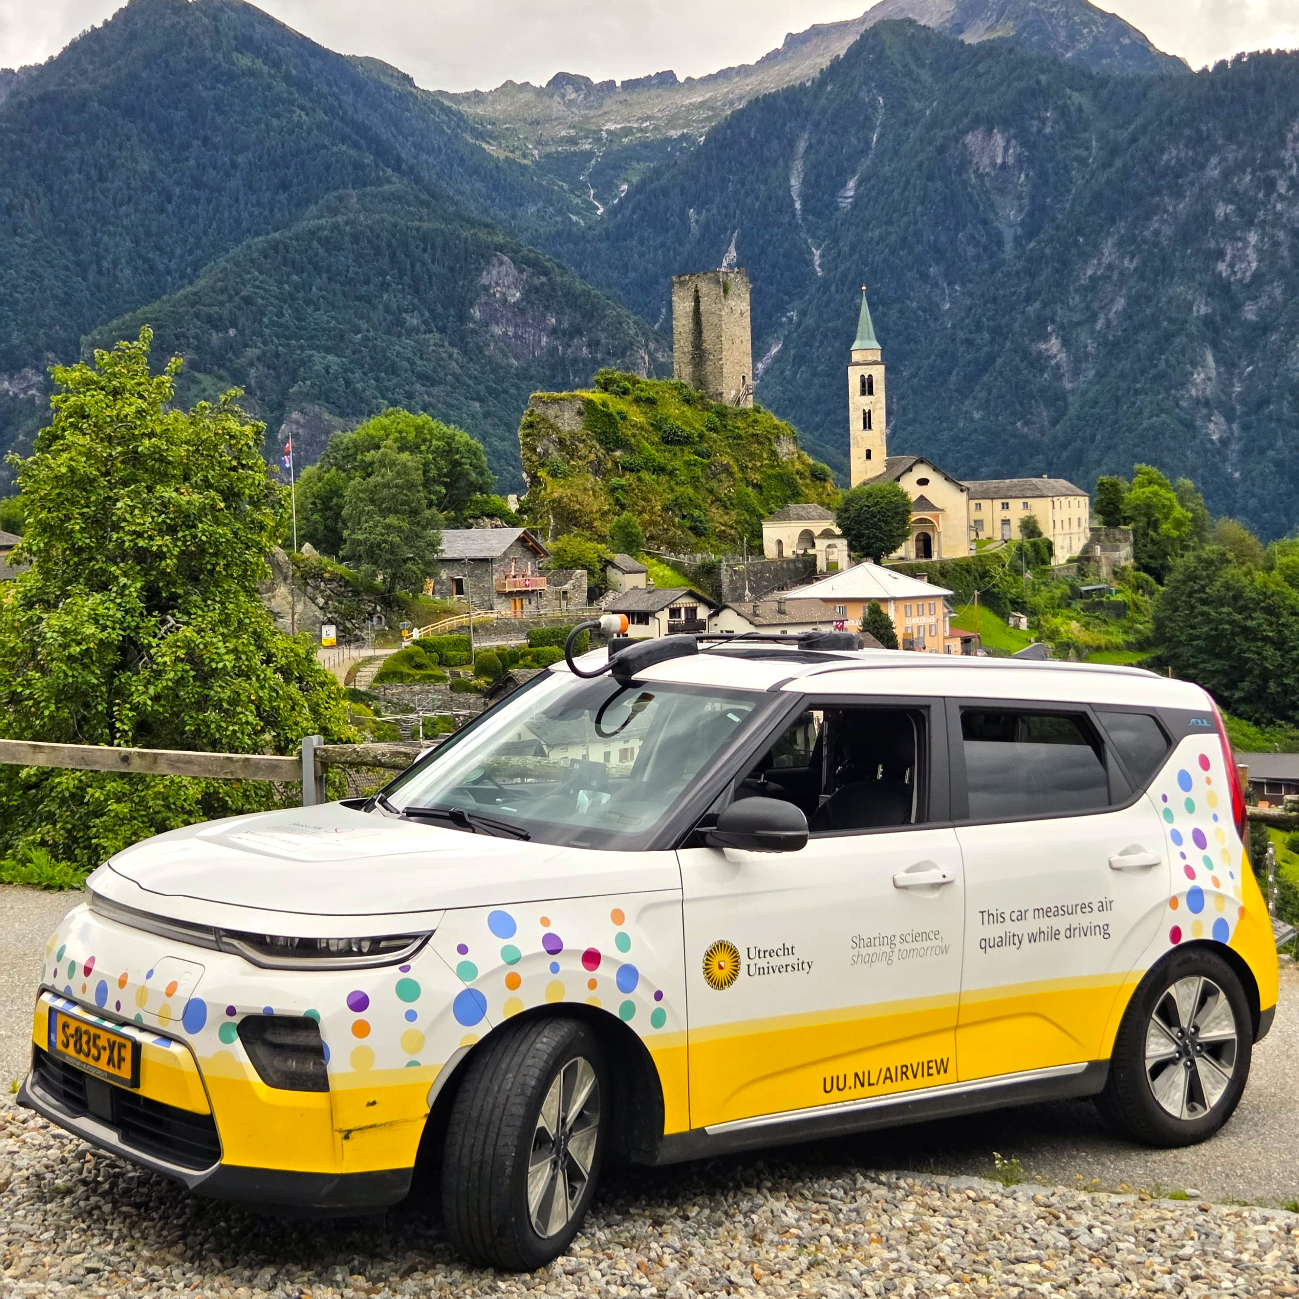
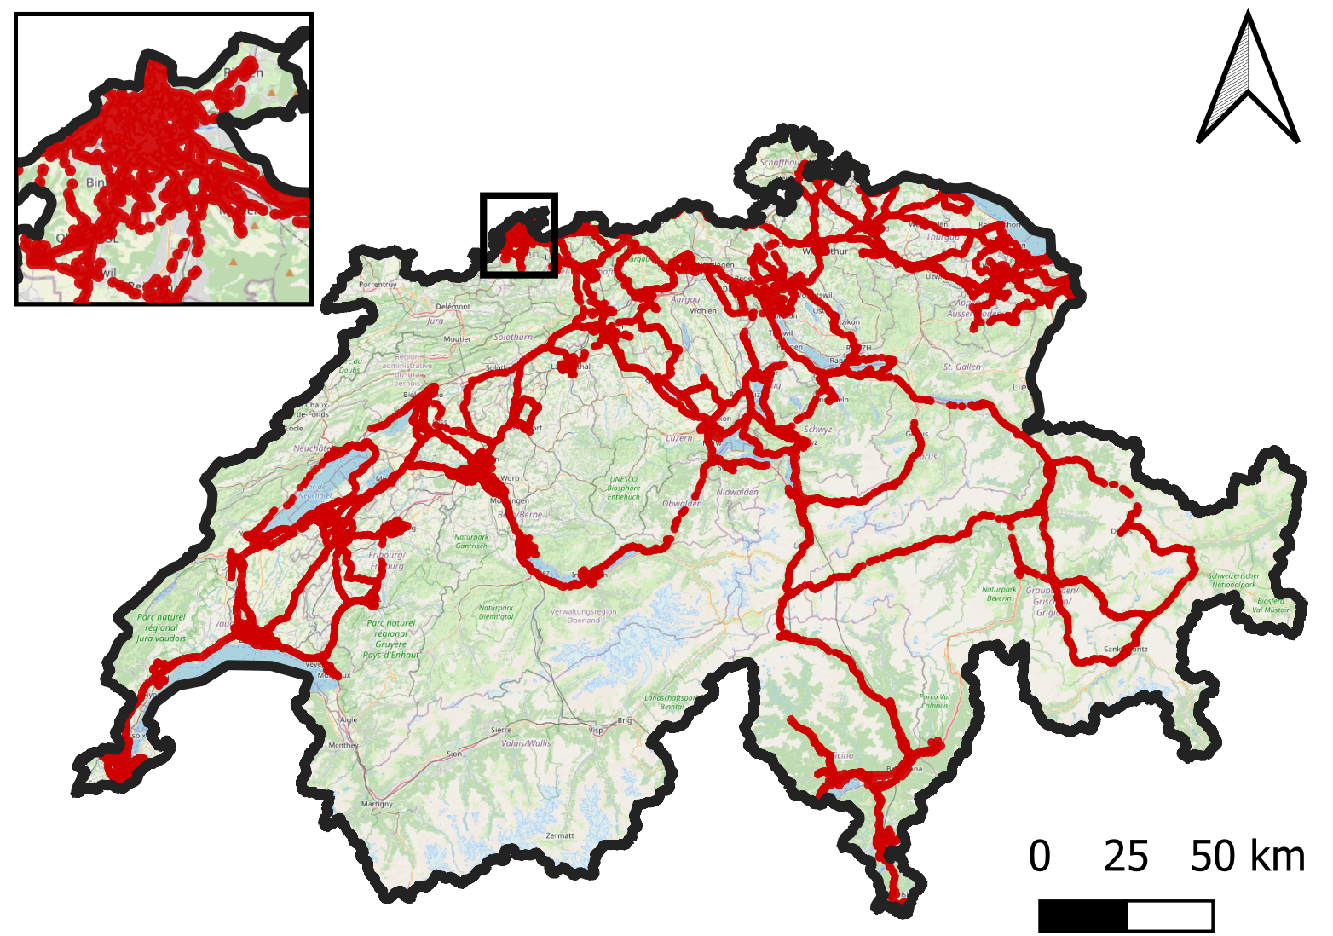
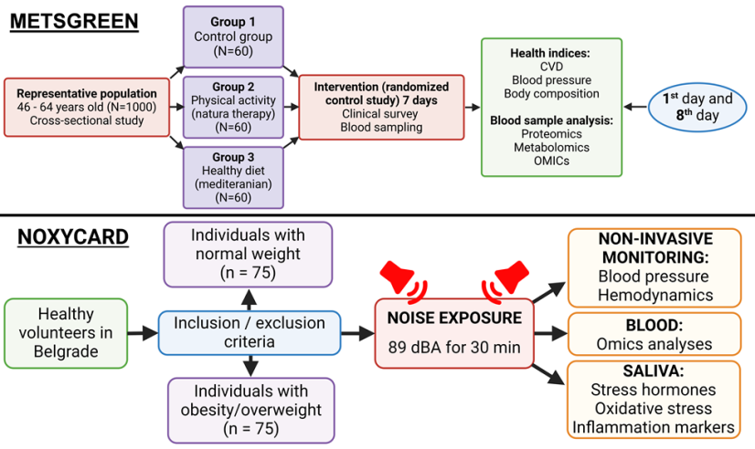
Scientific approach - highlights
Sophisticated animal exposure systems for combined effects of noise and PM (UFP) in mice (and cell culture) with pre-existing NCDs, drug interventions and genetic approaches, duration/sex/age; advanced functional, biochemical and imaging methods – UMC-Mainz & UEF & UNIPD & MUSC
Large cohorts with detailed exposure data (SNC, >8 million health datasets & DNC, >5 million health datasets) for reliable health outcomes for vulnerable subgroup analysis, multi-exposure approaches, UFP measuring campaign – TPH & DCS
Interventional clinical trials for additive effects of noise or UFP exposure in obese patients and metabolic syndrome patients (NOXYCARD & METSGREEN) – MFUB/VINS & VMU

Slide 9
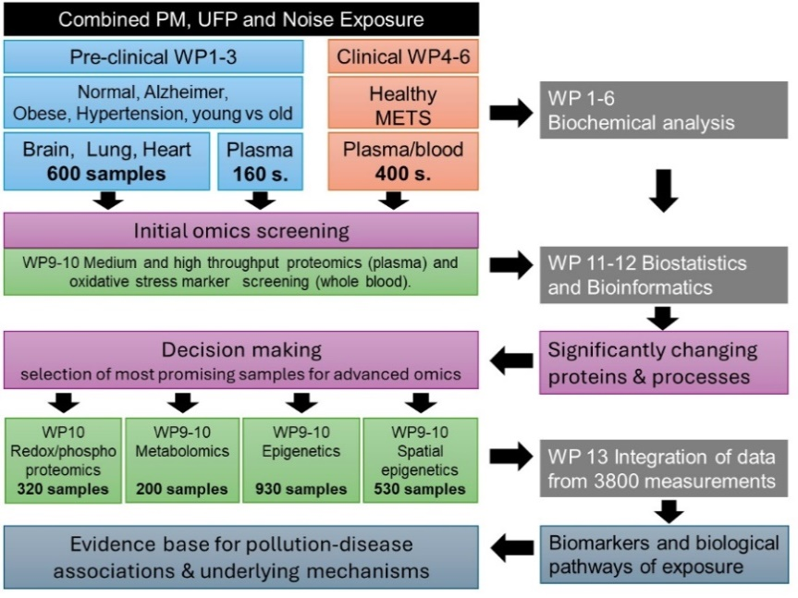
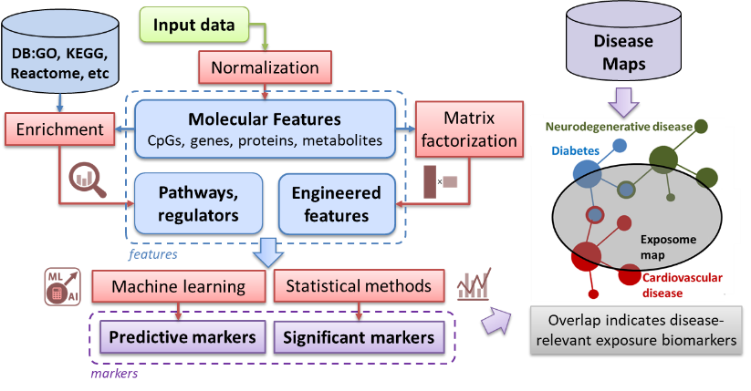
Scientific approach - highlights
Computational modeling approaches for UFP-associated CVD incidence at the global and European level (EMAC & GEMM & GBD) and prediction of lung damage by different particle categories with different toxic contaminants (KM-SUB-ELF) – CYI & MPIC
Advanced OMICs including redox/phospho-proteomics, spatial epigenetics, DNA methylation, untargeted metabolomics – SDU & UMC-Mainz/LNS & UEF
Overarching advanced bioinformatics making use of existing large preclinical RNAseq data for noise and/or PM2.5 exposures with drug interventions and pre-existing chronic disease as well as novel human and mouse OMICs data; search for overlap of exposure OMICs signatures with existing diseasome maps – LIH
Framework analysis of knowledge transfer and legislative processes at the environment/health interface in different political contexts - JMU

Slide 10
Current status
WP1-3: mouse exposure studies for combined effects of PM/UFP and aircraft noise have started at UMC-Mainz and UEF. Exposure systems are set-up at UNIPD and MUSC.
WP4-6: measurement campaign for UFP in Switzerland and Kaunas (Lithuania) started.
WP7-8: initial UFP exposure-CVD incidence modeling at 10x10km resolution (global and Europe) published. Improving the resolution to 1x1km in progress.
WP9-10: initial proteomic analysis of frozen mouse samples from previous studies (3d noise and/or PM2.5; 3d nano versus micro particles; 4w noise) is completed in three tissues (lung, brain and heart) yielding novel ideas and concepts.
WP11-13: initial bioinformatical analysis of previous RNAseq data (overarching approach over various exposure conditions, interventions and different exposure systems) is in progress.
WP20: starts in year 2

Slide 11
Key expected results
Deep mechanistic insights into disease-relevant pathomechanisms from preclinical studies
New biomarkers for precise assessment and early detection of at-risk groups
Computational model of PM2.5-mediated oxidative reactions and damage of biomolecules in epithelial lining fluid
Exposure-risk assessment from computional modeling and empiric exposure data for UFP (and other exposures) – will allow comparison of these approaches
Novel tools, for evidence based decision making (gene expression web-based explorer, exposure models, oxidative potential for particle toxicity, METS score)
Better understanding of knowledge transfer processes from science to decision makers

Slide 12
Expected political and societal impact
By pioneering a “bench to life” approach to study the combined effects of noise and particulate matter (PM), including ultrafine particles (UFPs) and toxins, MARKOPOLO integrates diverse scientific disciplines to address both scientific and societal challenges.
Scientific: The project investigates the health impacts of noise and air pollution, emphasizing vulnerable populations and improving FAIR data practices. MARKOPOLO aims to uncover causal mechanisms for effective interventions, assess the role of UFP metrics in disease risk, and advocate for stricter UFP emission standards.
Technological: The project enhances disease burden estimates by refining exposure-response functions and identifying key biomarkers for noise and UFP exposure. These advancements improve risk predictions, validate interventions, and leverage innovative tools and technologies.
Socioeconomic: The project supports regulatory efforts by providing evidence for risk assessments, guidelines, and standards. It raises awareness of environmental hazards, reduces healthcare costs, and improves quality of life. MARKOPOLO addresses climate change impacts, aligning with the European Green Deal to create a healthier, more sustainable environment.

Slide 13
https://markersofpollution-markopolo.eu/

